Slide 1
Preparing & Delivering PRESENTATIONS

Slide 2
What to expect
Two classes: Nov 24 and Dec 1
Nov 24: presentation tips
Dec 1: student (team) presentations
Make your own teams of 3-5 students
Make a 10 minute presentation
Topic: Profile 3 different entrepreneurs
Peer reviews at the end of each presentation

Slide 5
Most people don’t like making presentations
Why?

Slide 6
There are two types of speakers. Those that are nervous and those that are liars.
Mark Twain

Slide 7
Part 1
Delivery tips
Part 2
PowerPoint tips
Part 3
Content tips
Part 4
Know your audience

Slide 8
DELIVERY

Slide 9
In your groups…
What are delivery ‘best practices’?
What do you like or admire that you have seen in great presenters?
What are delivery ‘bad practices’?
What do you dislike that you have seen in poor presenters?
0
1
0
1
2
3
4
5
6
7
8
9
0
minutes

Slide 10
Focus is on YOU!
Slides and props provide EMPHASIS.

Slide 11
Focus is on YOU!
Slides provide EMPHASIS.
Read a script
Put up boring slides

Slide 12
Focus is on YOU!
Slides provide EMPHASIS.
Present without a script
Slides support you
Read a script
Put up boring slides

Slide 13
Focus is on YOU
Slides provide EMPHASIS
Present without a script
Slides support you
Present without a script
Strong connection
Slides provide emphasis
Read a script
Put up boring slides

Slide 14
Speak casually without reading
Change pitch and tone.

Slide 15
Interact & engage

Slide 16
Make eye contact
around the room

Slide 17
Dress appropriately
Watch your body language
(even those waiting!)

Slide 18
Move around

Slide 19
Podium and Microphone Presentations

Slide 20
Smooth transition between speakers

Slide 21
Be aware…

Slide 22
Cultural Sensitivities
Images vs text
Pre-reads vs leave-behinds
Inappropriate images and colours
Body language
Hand gestures
Personal space
Eye contact
Value of time
DO YOUR RESEARCH!

Slide 23
Summary so far…
Speak casually without notes
Change pitch and tone
Interact and engage, move around
Make eye contact
Dress appropriately
Watch body language
Smooth transition between speakers
Be culturally aware

Slide 25
Benjamin Franklin

Slide 27
“The more you
sweat
in practice, the less you
bleed
in battle”

Slide 28
These people practice!
Athletes
Pilots
Debaters
Actors
Musicians
Magicians
Dancers
Successful people practice!

Slide 29
Try this at least once when you practice…
Exaggerate your pitch and tone

Slide 30
Practice helps…
with timing and flow
with familiarity of material
manage the equipment
familiarize with the room
practice your body language and eye contact
increase confidence
lower stress and nervousness

Slide 31
LOGISTICAL TIPS
Be early!

Slide 32
Know the room
Where will you stand
Where will your team sit
Where is the equipment
Props and easels
Lighting control
Sound control
WIFI password

Slide 33
If you are REALLY good…
Have an emergency backup plan!
Technology can fail
Laptop
Projector
Flash drive
Notes:
Examples:
Canada Post
Shubenacadie

Slide 34
Slides

Slide 35
In your groups…
What are presentation (slides) ‘best practices’?
What do you like or admire that you have seen in great PowerPoint slides?
What are presentation (slides) ‘bad practices’?
What do you dislike that you have seen in poor PowerPoint slides?
0
0
1
2
3
4
5
6
7
minutes

Slide 36
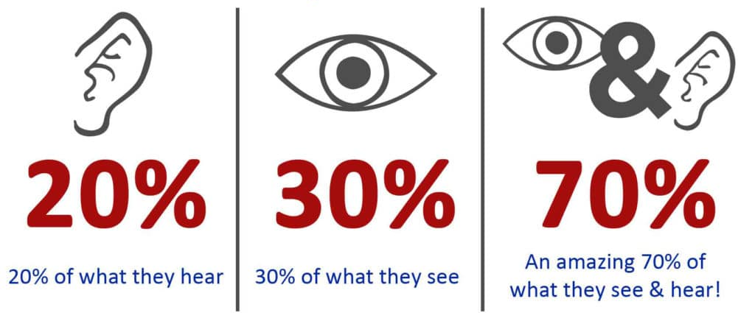
Why do we use slides? Because people remember…

Slide 37
Content management (slides)
Read a script
Put up boring slides
Short bullets
Some visuals

Slide 38
Content management (slides)
Some visuals
Short bullets
ONE AT A TIME
Present without a script
Slides support you
Short bullets
Some visuals

Slide 39
Content management (slides)
Some visuals
Short bullets
ONE AT A TIME
Some visuals
Short bullets
ONE AT A TIME
WITH EMPHASIS
(others leave or are deemphasized)
Present without a script
Strong connection
Slides provide emphasis
Short bullets
Some visuals

Slide 40
Writing your bullets
You should always use very short phrases, never full sentences that take longer to read
Editing is hard, but you should ruthlessly edit!
Always use a minimum 28 point font to ensure that it can be read from a distance
Older people have more trouble reading, so here’s a tip: divide the age of the oldest person in the room by two and use that as your font size!
Choose a font colour that ensures strong colour contrast

Slide 41
Writing your bullets
Use very short phrases
Ruthlessly edit!
Minimum 28 point font
divide the age of the oldest person in the room by two!
Ensure colour contrast

Slide 42
Writing your bullets
You should always use very short phrases, never full sentences that take longer to read
Editing is hard, but you should ruthlessly edit!
Always us a minimum 28 point font to ensure that it can be read from a distance
Older people have more trouble reading, so here’s a tip: divide the age of the oldest person in the room by two and use that as your font size!
Choose a font colour that ensures strong colour contrast
88

Slide 43
Writing
Use very short phrases
Ruthlessly edit!
Minimum 28 point font
divide the age of the oldest person in the room by two!
Ensure colour contrast
31

Slide 44
The shorter, the better…
Sentence length | Comprehension rate
8 words | 100 percent
15 words | 90 percent
19 words | 80 percent
28 words | 50 percent
Notes:
Effective sentences are short and stress important ideas. Sentences of 20 or fewer words are easiest to understand.

Slide 45
I didn’t have time to write a short letter so I wrote a long one instead.
Mark Twain

Slide 46
Edit, edit, edit
Cut mercilessly. Never stop, and never fall in love with your own words.

Slide 47
What’s the problem?
What happens when I use a slide like this?
All of the bullets appeared at once.
The audience will try to read them all.
They are no longer listening to me!
They also don’t know which line to focus on.
This leads to poor presentations.

Slide 48
Does this work better?
Enter the bullets one at a time
Audience can’t read ahead
They focus on one thought at a time
They will listen better
Visuals help make your point
This is a BEST PRACTICE
LEARN
MORE

Slide 49
Choose an ENTRANCE animation
My favorites are…
Fade
Zoom
Grow and Turn
Avoid being too gimmicky!
LEARN
MORE

Slide 50
Enter bullets ONE at a time
I also like FLY IN
FLY IN from the bottom
FLY IN from the top
FLY IN from the left
FLY IN from the right
LEARN
MORE

Slide 51
Now DEEMPHASIZE your bullets
I make an important point
I proceed to my second important point
The preceding line is DEEMPHASIZED
This focuses the audience on my current line
LEARN
MORE

Slide 52
SkillsPlus.ca/smu

Slide 53
Image
Add strong, relevant images
LEARN
MORE

Slide 54
Image
Consider using ONLY an image
LEARN
MORE

Slide 55
Teen Fatalities
“Research shows that 70% of preventable teen deaths are due to careless driving”

Slide 56
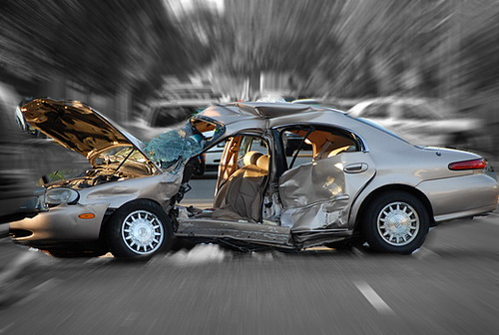

Slide 57
Benefits of E-Commerce
Access to consumers around the world
Open 24/7, 365 days a year
Convenient to shop from home
Lower operating costs
Can offer new products and promotions fast
No worries about handling cash

Slide 58
Benefits of E-Commerce
Convenient
Global
Lower costs
LEARN
MORE
Products & promos
365 days, 24/7
No cash hassles

Slide 59
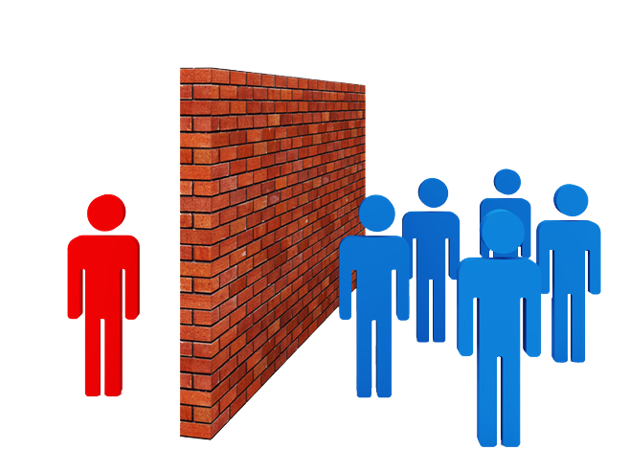
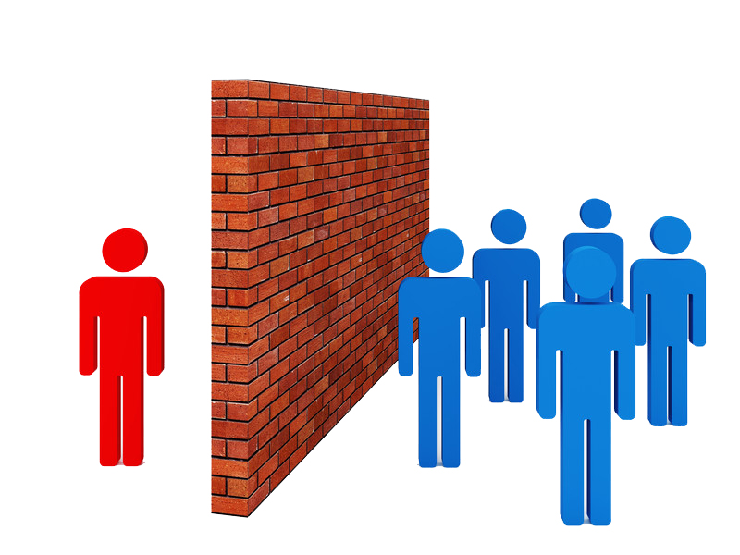
Avoid white backgrounds on images used on a dark background
This is a JPEG
Use PNGs with a transparent background

Slide 60
Avoid white backgrounds on images used on a dark background.
Sometimes a white slide background is better!

Slide 61
These graphics ENTER and EXIT
These bullets enter one at a time
A corresponding image enters too.
Each image exits while another one enters
And they are linked to different bullets
It gives you complete control
LEARN
MORE

Slide 62
SkillsPlus.ca/smu

Slide 63
SkillsPlus.ca/smu

Slide 64
SkillsPlus.ca/smu
LEARN
MORE

Slide 65
SUMMARY
Confidently deliver without a script
Practice makes perfect!
Use SHORT text bullets
Enhance with IMAGES
Control your content
One bullet at a time
Exit or deemphasize previous points as you progress

Slide 66
Content control

Slide 67
Never assume!
Agenda

Slide 69
PART 1) ATTENTION
“Did you know that the number one cause of preventable deaths among teenagers is motor vehicle accidents?”

Slide 70
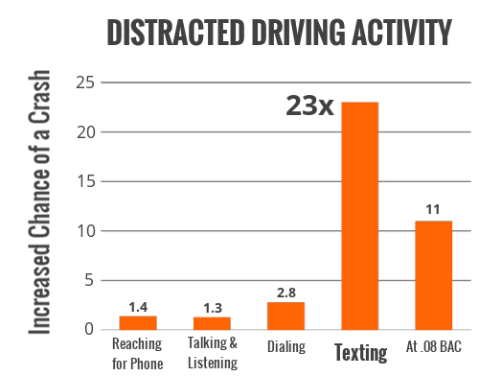
PART 2) INTEREST
“Research shows that new teenage drivers are over-confidant and are easily distracted by smartphones.”

Slide 71
PART 3) DESIRE
“As a leading expert in accident investigations, I can tell you that safe driving courses reduce distracted driving incidents.”

Slide 72
PART 4) ACTION
“Enrol your son in our safe driving course now to ensure that they are not the next casualty”

Slide 73
PART 1) ATTENTION
“Staff turnover has increased 40% this year, costing us thousands in additional hiring and training costs.”

Slide 74
PART 2) INTEREST
“The Human Resource Association of Canada has shown that flexible hours can reduce turnover by 20%.”

Slide 75
PART 3) DESIRE
“We can save the company $50,000 by implementing flexible hours in the workplace”

Slide 76
PART 4) ACTION
“Please approve this plan by December 9th. The sooner we can implement, the sooner we will realize savings”

Slide 77
PART 1) ATTENTION
“Lions will be extinct in our lifetime.”

Slide 78
PART 2) INTEREST
“Just over a century ago, there were more than 200,000 wild lions living in Africa. Today, there are only about 20,000. Lions are now extinct in 26 African countries.”

Slide 79
PART 3) DESIRE
“Your donation supports on-the-ground conservation projects for lions, cheetahs, and other wildlife; combats poaching and snaring; and helps local communities that live with big cats.”

Slide 80
PART 4) ACTION
“Donate now and receive this special plush lion!”

Slide 81
PART 1) ATTENTION
“Have you ever wondered what yellows your teeth?

Slide 82
PART 2) INTEREST
“The most common causes of tooth discoloration include drinking beverages such as coffee, soda, and wine. These substances get into the enamel of your teeth and can cause long-term discoloration”

Slide 83
PART 3) DESIRE
“Colgate Optic White Toothbrush can lift yellow tones in your teeth by removing stains and providing a mild bleaching effect when used as directed.”

Slide 84
PART 4) ACTION
“Don’t delay... restore your pearly whites in less than a week!”

Slide 85
PART 4) ACTION
“Order in the next hour and your shipping will be free.”

Slide 86
PART 1) ATTENTION
Use a provocative opening:
Problem
Unexpected statement
Compliment
Fascinating facts
Stimulating question

Slide 87
PART 2) INTEREST
Facts, figures
Expert opinions
Examples
Specific details
Direct benefits
Indirect benefits

Slide 88
PART 3) DESIRE
Elicit desire by doing the following:
Promoting the BENEFITS
Showing the value of your proposal
Reducing resistance
Anticipating objections
Offering counterarguments
Demonstrating competence

Slide 89
PART 4) ACTION
Prompt action by doing the following:
Describing specific request
Making action easy to take
Sounding confident
Offering an incentive or gift
Offering no excuses
Repeating the main benefits

Slide 91
Friendly
Try new things
Engage the audience
Be warm and pleasant
Use humour if appropriate
Take risks!

Slide 92
Neutral
Objectively present both sides of argument
Leave time for questions
Don’t be showy
Use facts, expert opinions
Avoid humour

Slide 93
Uninterested
Be brief!
Be dynamic and entertaining
Use humour
Include startling statistics, powerful visuals

Slide 94
Hostile
Avoid controversy
Stay calm, controlled
Include objective data, expert opinions
Avoid Q&A if possible

Slide 95
SUMMARY
Confidently deliver without a script
Practice makes perfect!
Use SHORT text bullets
Enhance with IMAGES
Control your content
One bullet at a time
Exit or deemphasize previous points as you progress

