Slide 1
The Business Side of

Slide 2
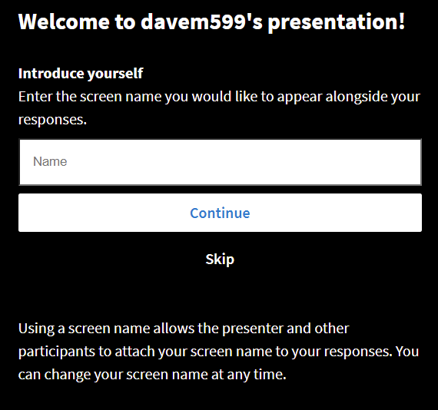
Please go to this web address to submit responses
Go to
pollev.com/davem599
on your phone,
tablet or computer
Select Continue

Slide 3
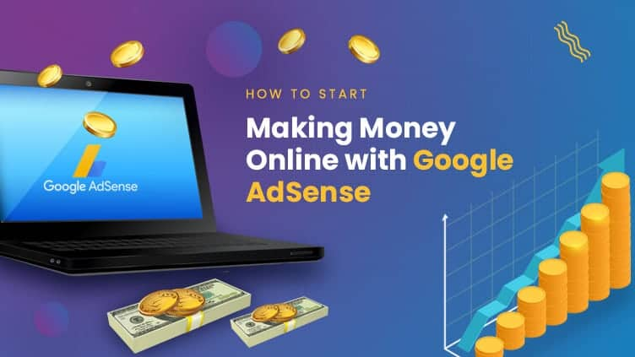

Slide 4
The YouTube Business Model
Compelling Content
Generates traffic (viewers)
High traffic attracts advertisers

Slide 5
The Online Business Model
Content Creator
Generates traffic (viewers)
High traffic attracts advertisers

Slide 6
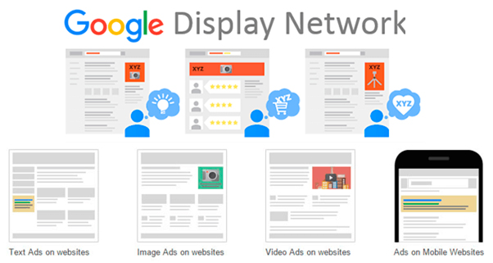
CONTENT DEVELOPERS

Slide 7
Add one piece of code to your site and Google will automatically show ads tailored to your site's layout.

Slide 9
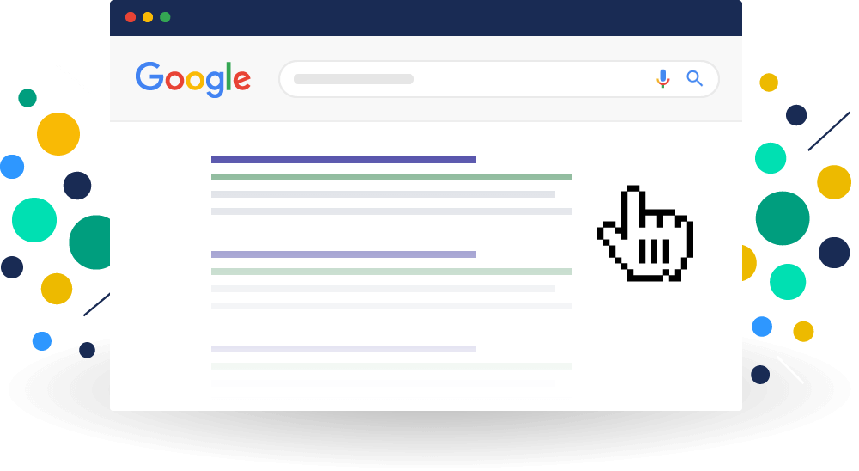

Slide 10
EARNED
OWNED
PAID
SHARED

Slide 11
EARNED
SEO
OWNED

Slide 12
HINT: SEO stands for:
S E A R C H E N G I N E
O P T I M I Z A T I O N

Slide 13
Google Search Engine

Slide 14
Organic Search Optimization
OWNED
EARNED
Build your page rank
Frequent use of keywords
Inbound links, which builds your credibility
Strategic use of page name and headers
Name your photos
Remember, Google only scans text, it cannot scan text in pictures
Keep your content fresh
Blogs are searched as well
Time adds to page rank

Slide 15
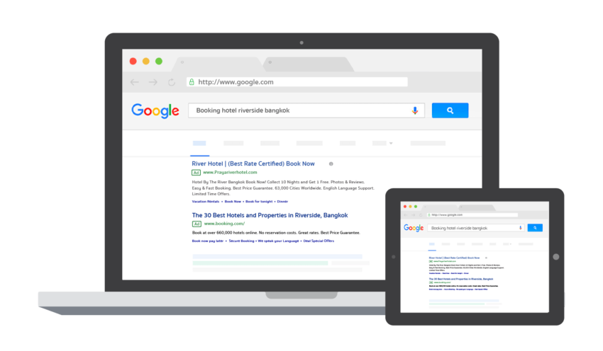
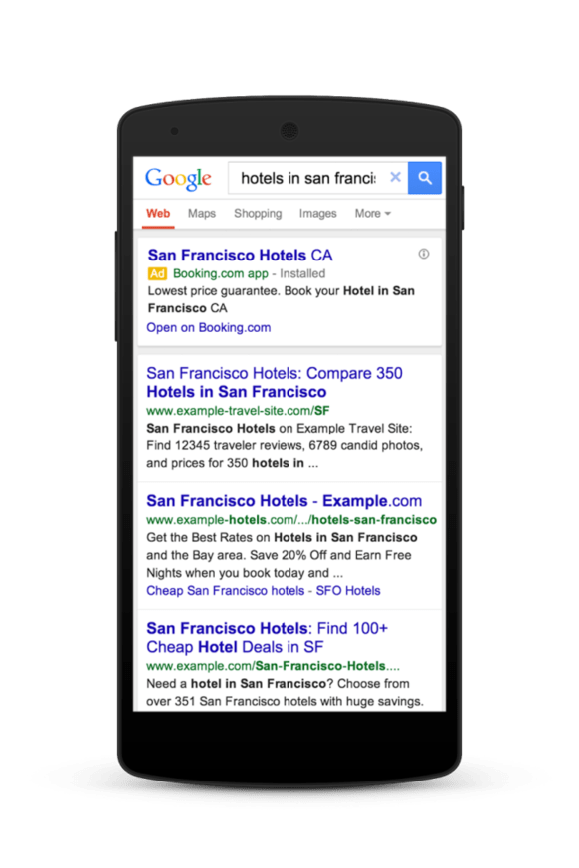
OWNED
PAID

Slide 16
Google Ads
A bidding process to deliver paid ads based on search queries
This is also based on the quality of your web page
You bid against competitors
Google considers the size of your bid and the quality of your page
Bidding is highly technical

Slide 17
Ad Rank

Slide 18
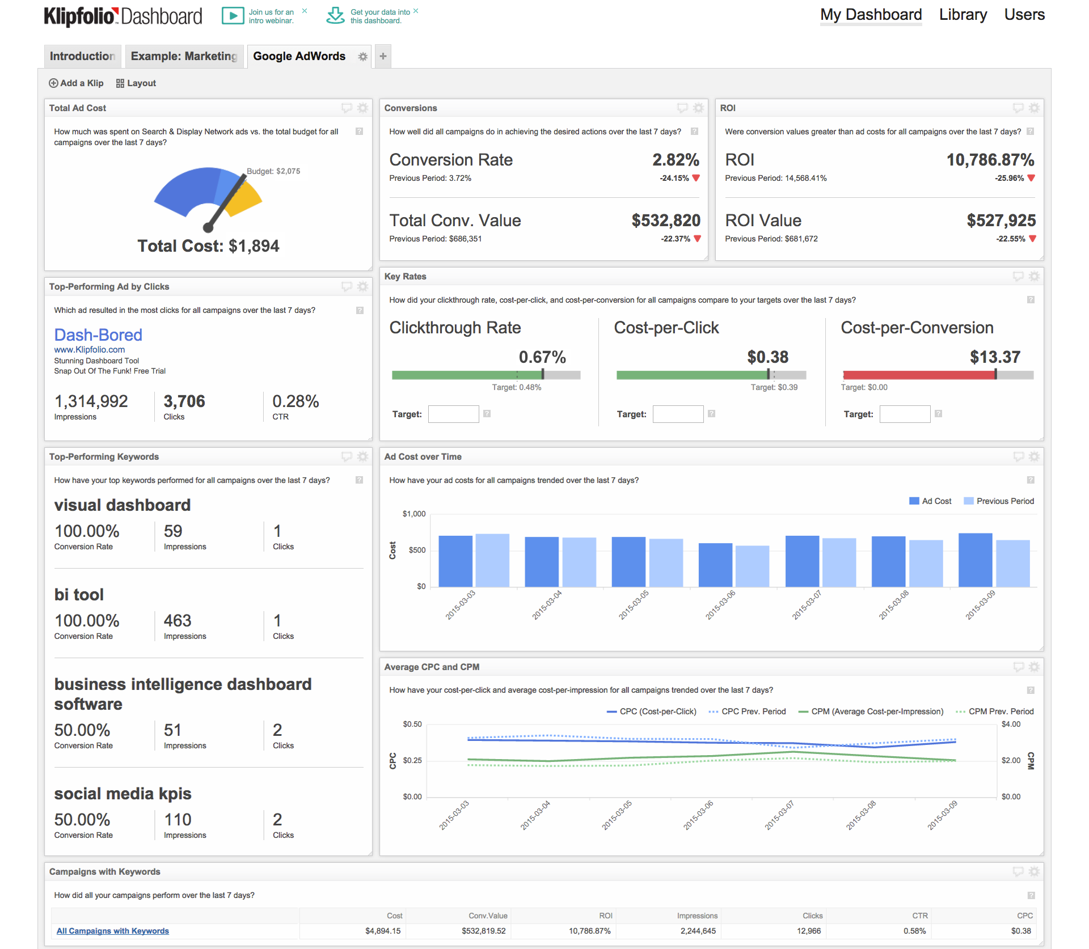
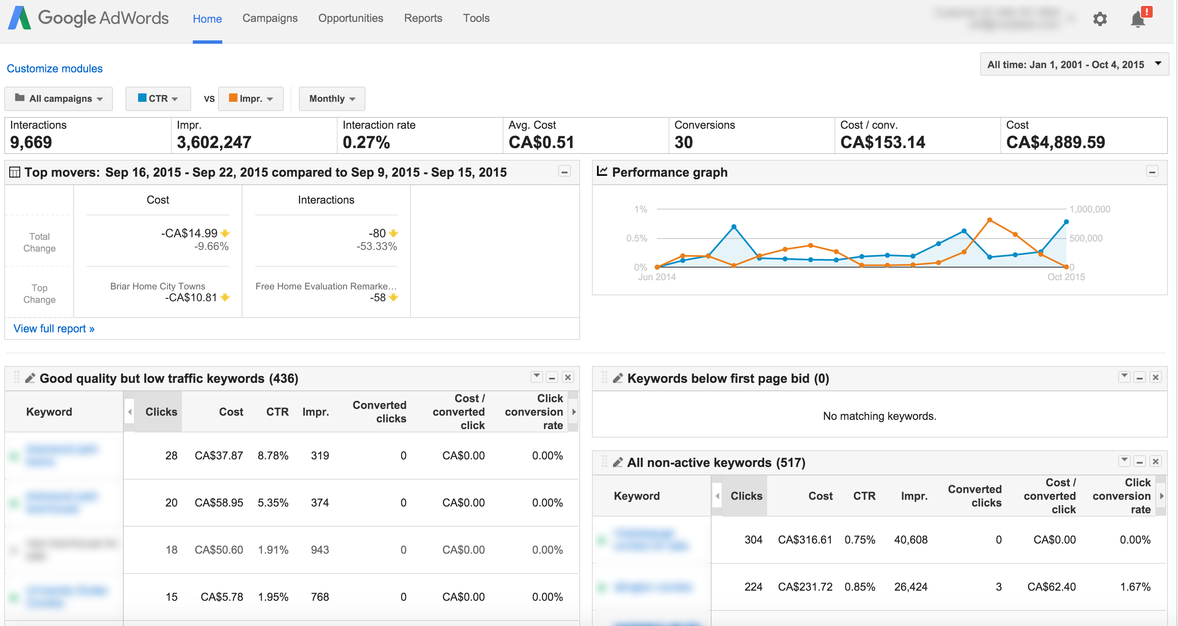
Dashboard

Slide 23
Volume
Relevant

Slide 24
Let’s do a search….
Give me a topic and we’ll search it

Slide 25
Display Ads

Slide 27
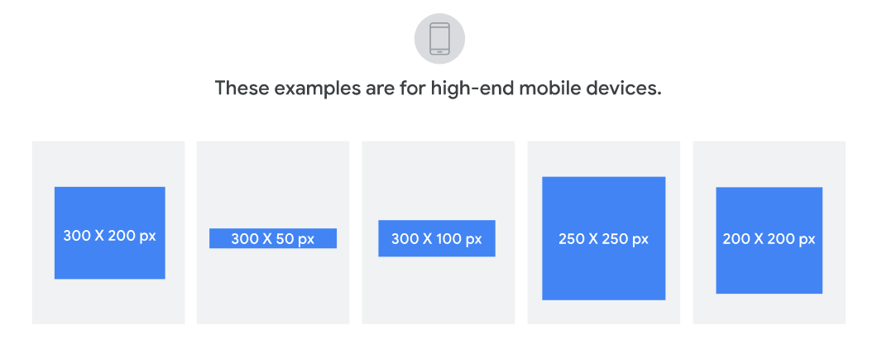

Slide 28
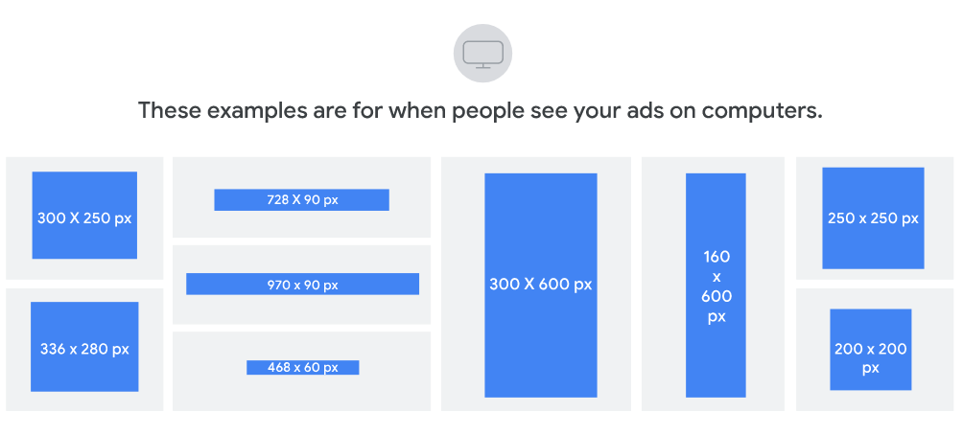

Slide 29
CONTENT DEVELOPERS

Slide 31
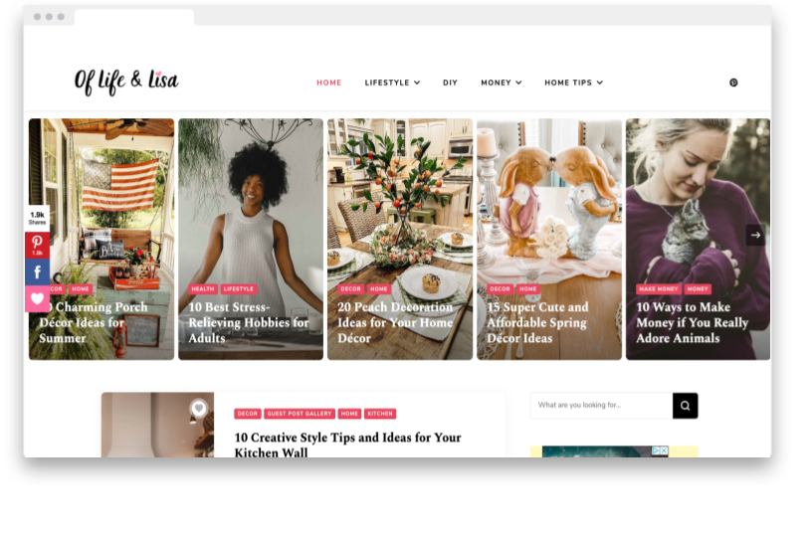

Slide 32
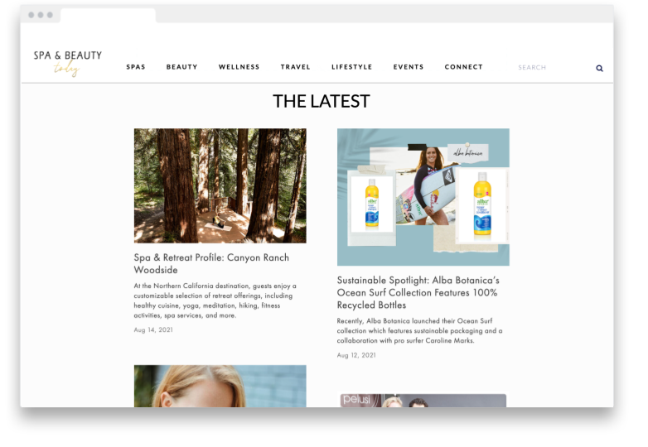

Slide 33
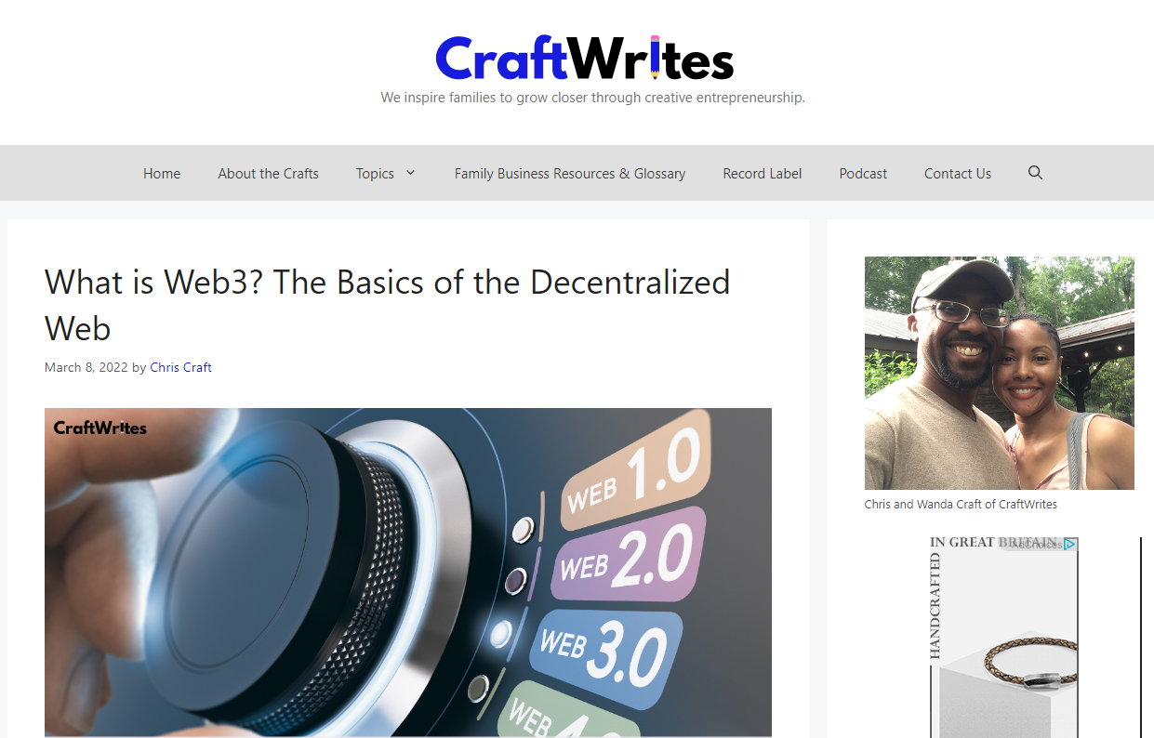

Slide 34
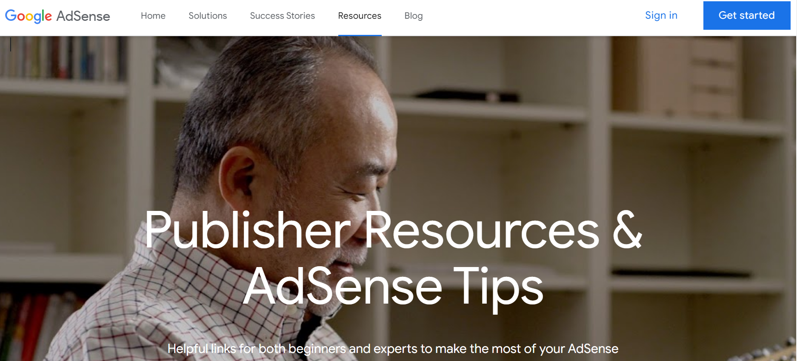

Slide 35
Notes:
Poll Title: Do not modify the notes in this section to avoid tampering with the Poll Everywhere activity. More info at polleverywhere.com/support What tools can you use to make your website engaging? https://www.polleverywhere.com/discourses/MBX1bAEvrxjb3F1o1IAGY

Slide 36
Website Tools
Highly relevant content (eg. Recipes)
Video
Podcasts
Newsletters
These are often used to identify and obtain customer leads
Blogs and forums
Community interaction

Slide 37
Website Tools
Webinars
Warranty/customer service
Engagement tools (customization apps, games, etc.)
Online chat
Apps and widgets (eg. Mortgage calculators, weather updates, currency converters, etc.)

Slide 38
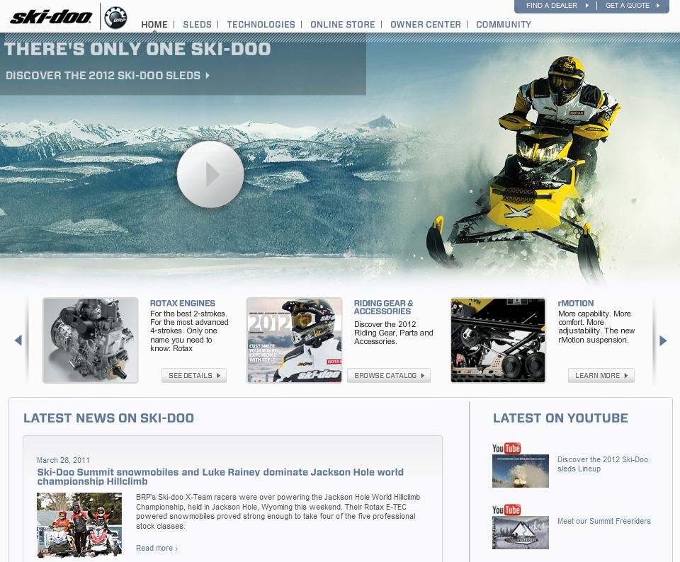
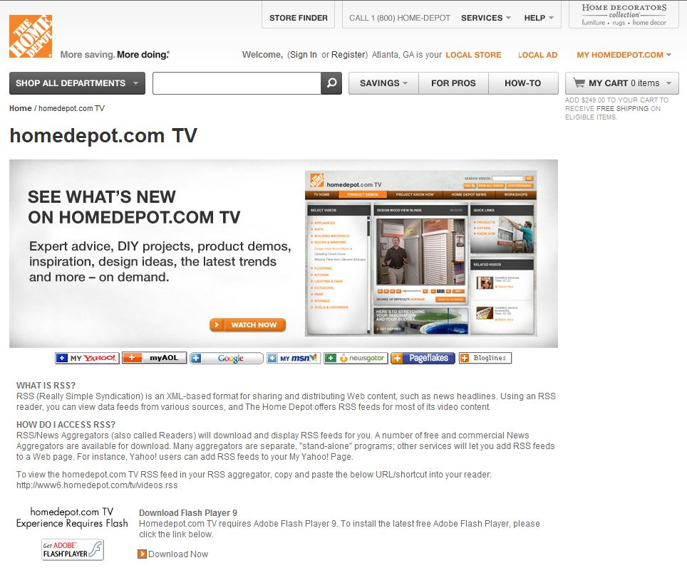
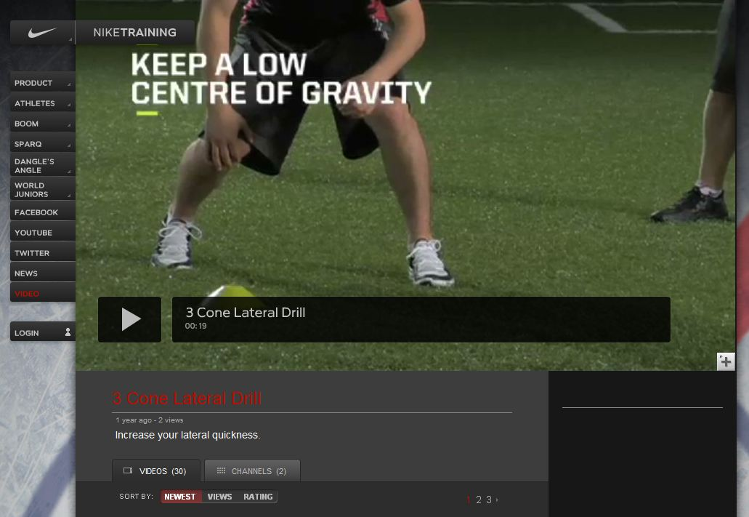
Video

Slide 39
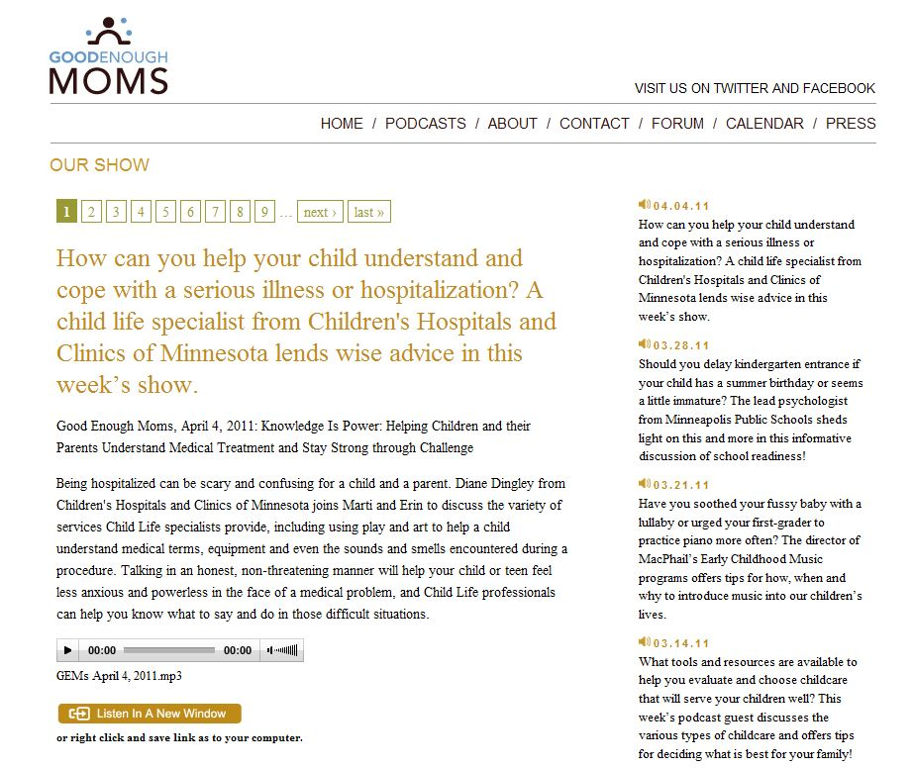
Podcasts

Slide 40
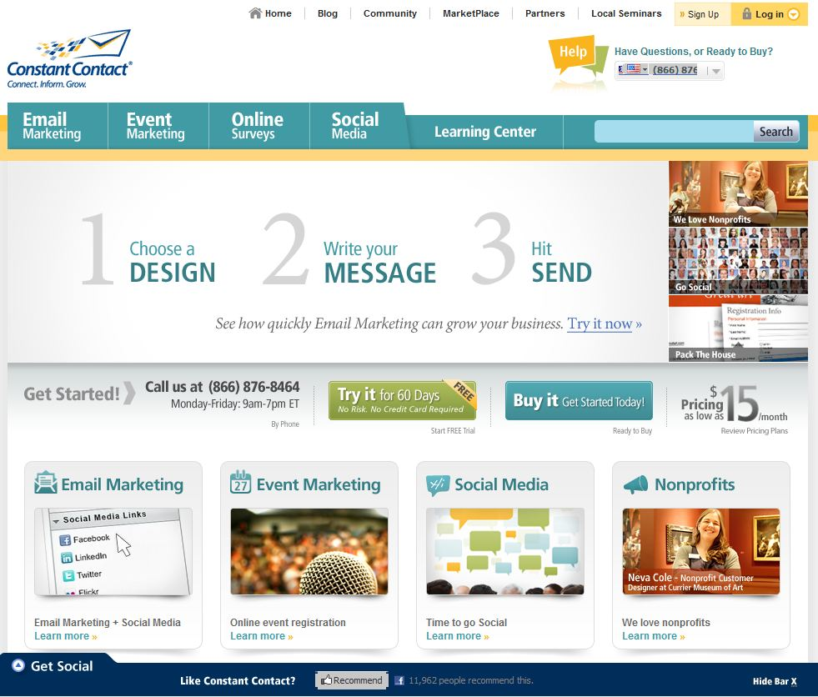
Emails and Newsletters

Slide 41
Blogs and Forums

Slide 42
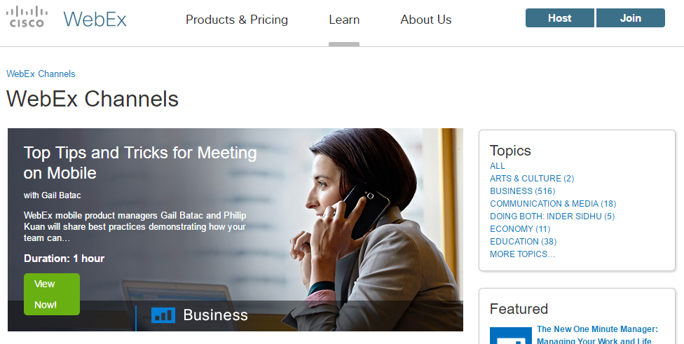
Webinars

Slide 43
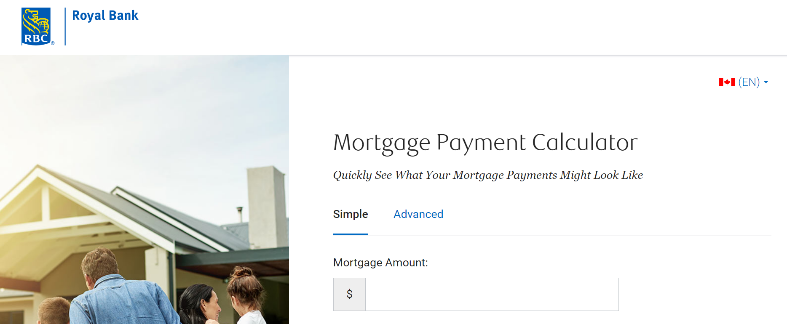
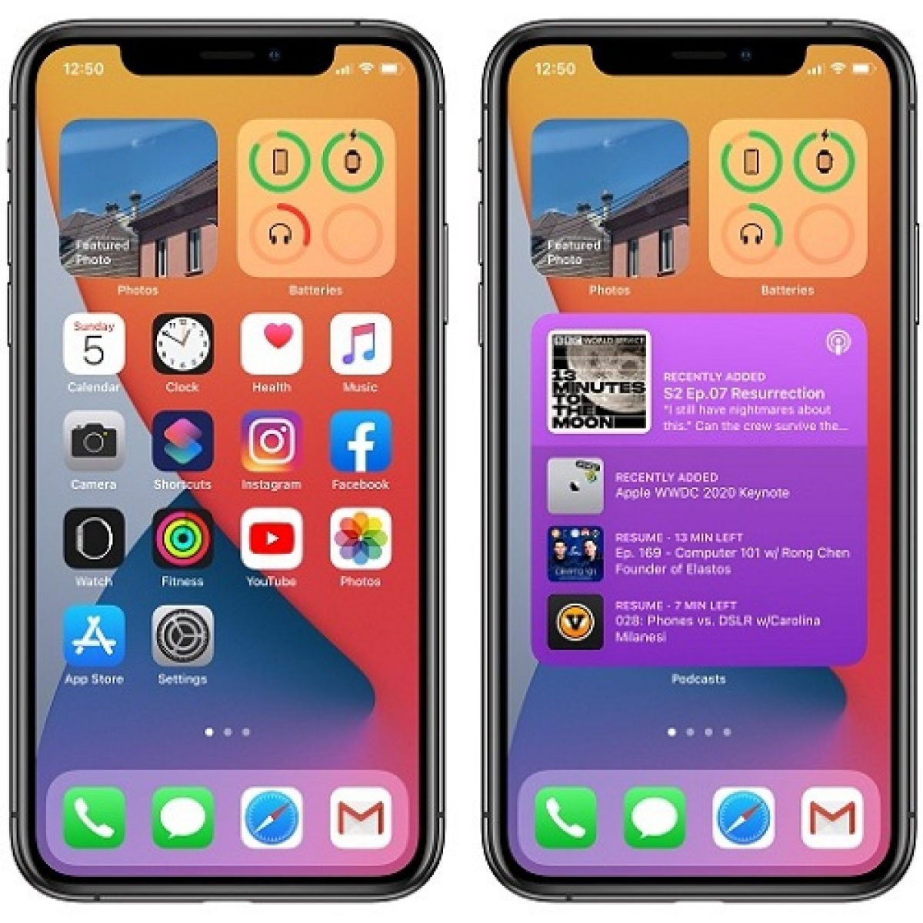
Widgets and Apps

Slide 44
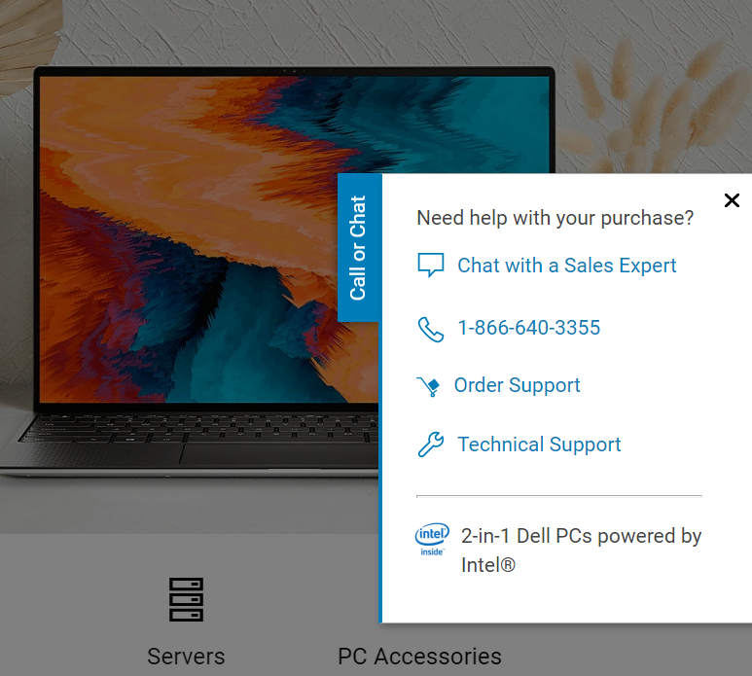
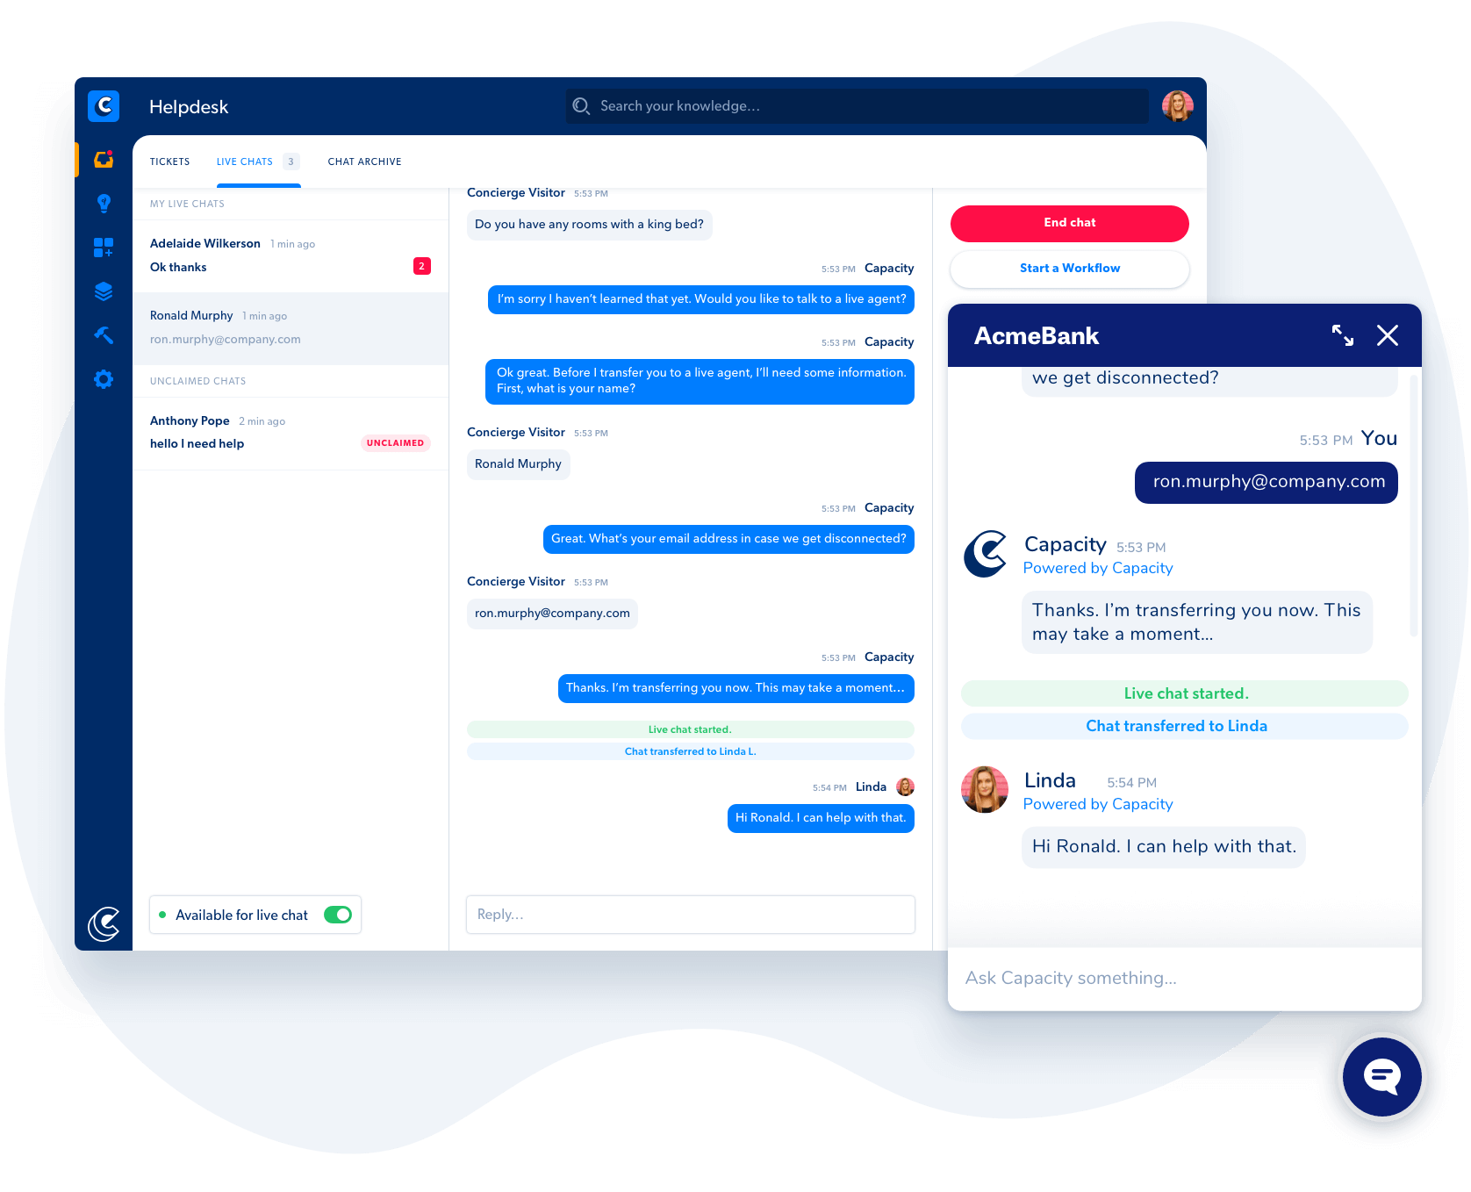
Live Chat

Slide 45
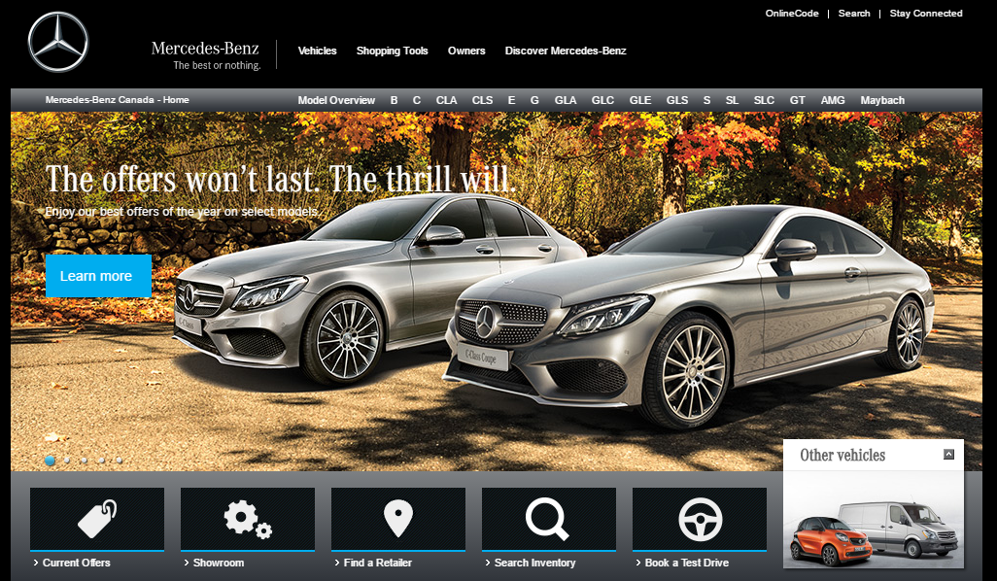
Customizations

Slide 46
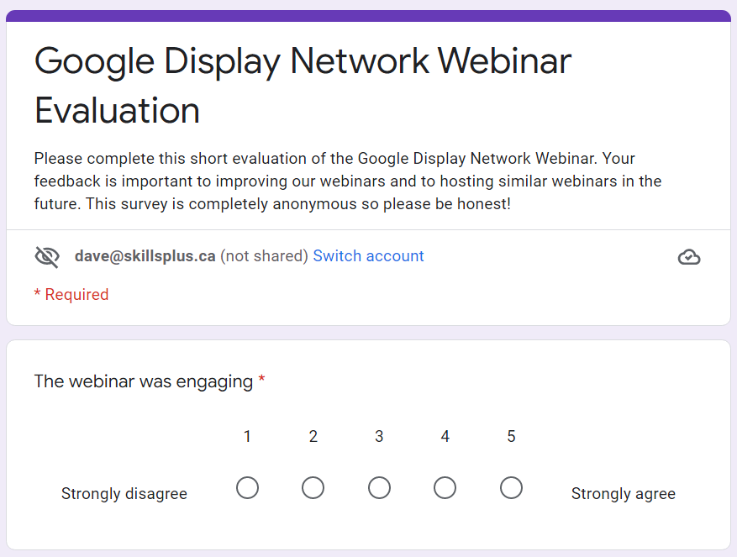

Slide 47
Website Functions
Provide key product information
Product demonstrations
Facilitate transactions, capture leads
Close a sale
Provide locations
Consumer feedback
Warranty support
Resource center (downloadable articles or links)
Generate additional sales
Provide added value
Support the brand!

