Slide 1
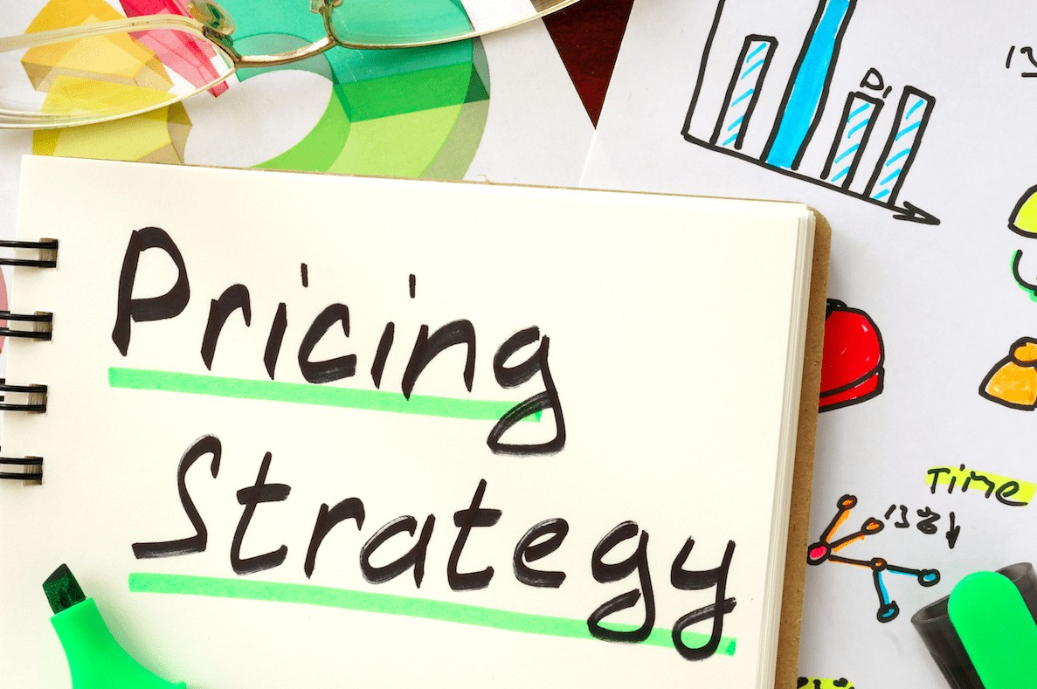
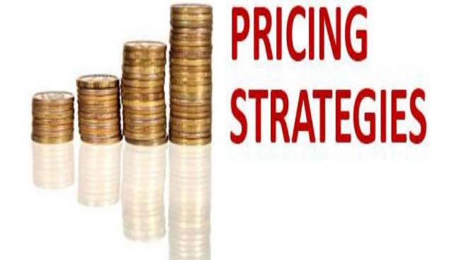

Slide 2
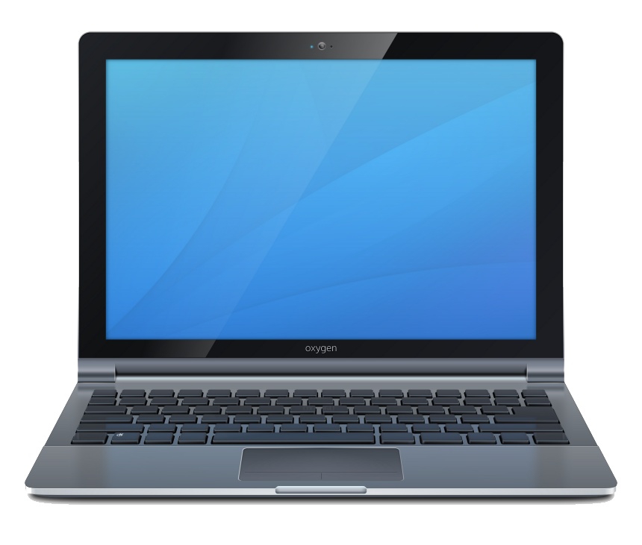
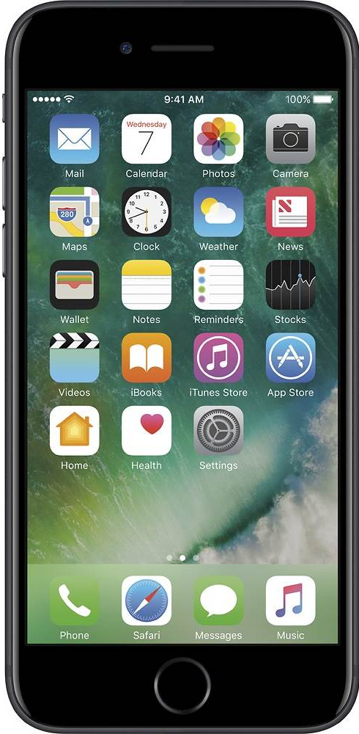
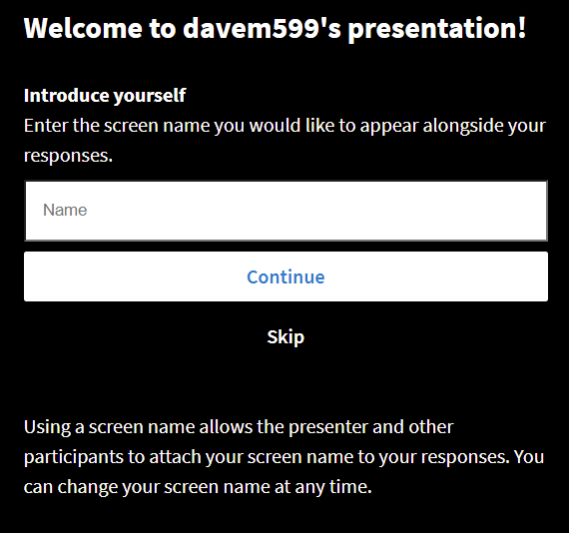
Go to
pollev.com/davem599
on your phone,
tablet or computer
Please go to this web address to submit responses
Select Continue

Slide 3
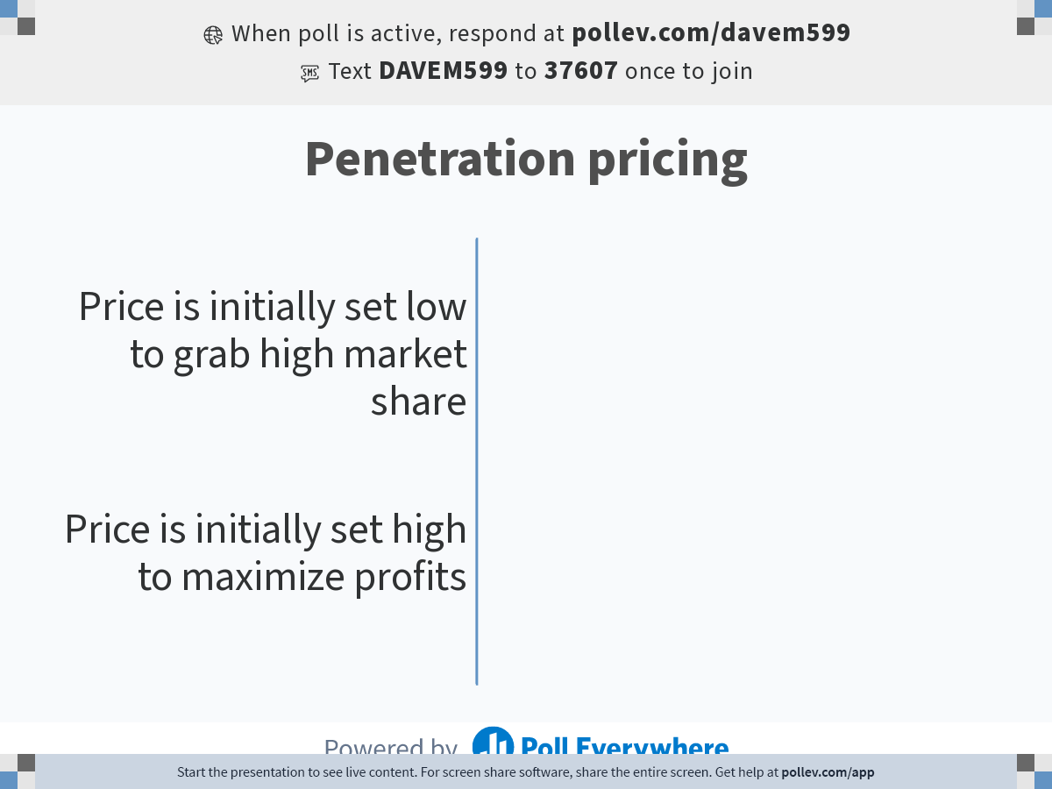
Notes:
Poll Title: Do not modify the notes in this section to avoid tampering with the Poll Everywhere activity.
More info at polleverywhere.com/support
Penetration pricing
https://www.polleverywhere.com/multiple_choice_polls/SVGU6ZeHv1FE1n6s95s6b?state=opened&flow=Default&onscreen=persist

Slide 4
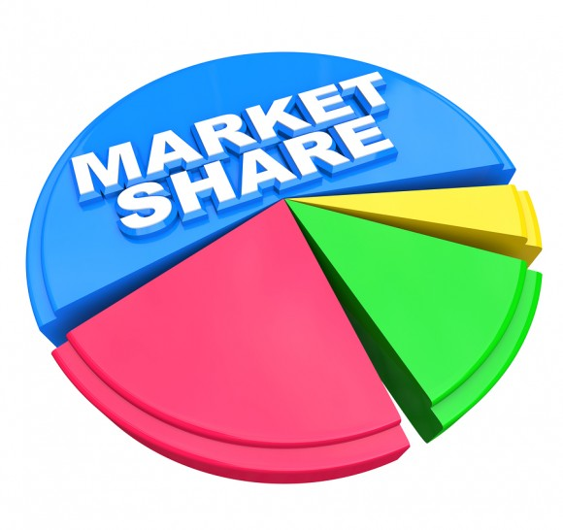
Penetration pricing
Price is initially set low to grab high market share

Slide 5
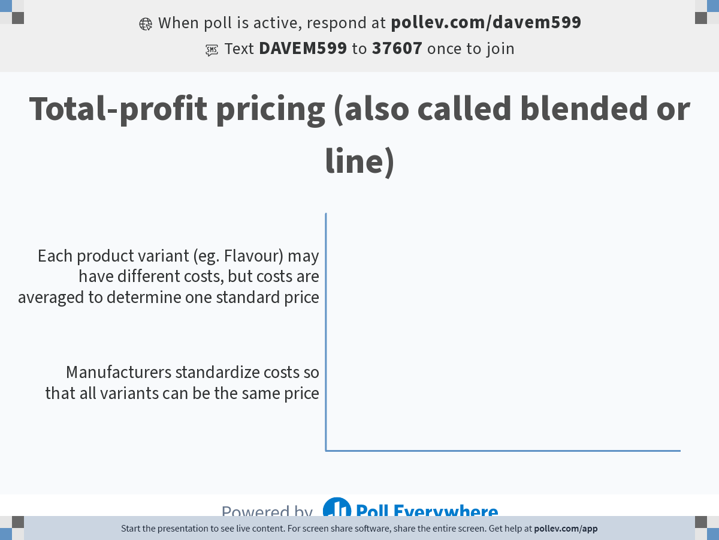
Notes:
Poll Title: Do not modify the notes in this section to avoid tampering with the Poll Everywhere activity.
More info at polleverywhere.com/support
Total-profit pricing (also called blended or line)
https://www.polleverywhere.com/multiple_choice_polls/99HIAuX9ISEcJ82PwKDUu?state=opened&flow=Default&onscreen=persist

Slide 6
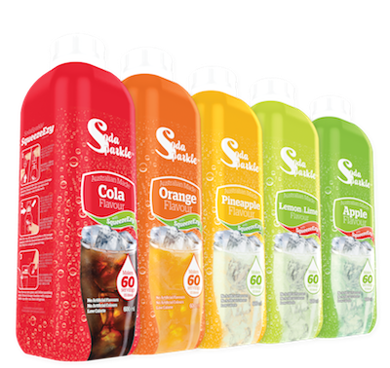
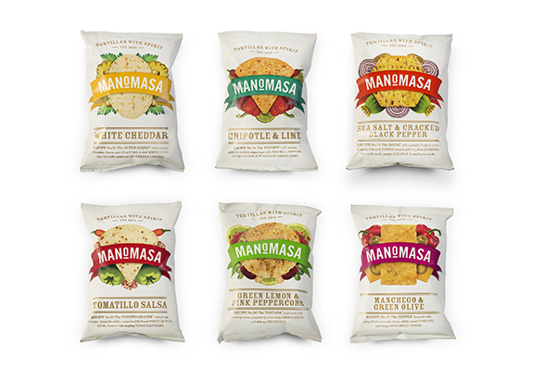
Total-profit pricing (also called blended or line)
Each product variant (eg. Flavour) may have different costs, but costs are averaged to determine one standard price

Slide 7
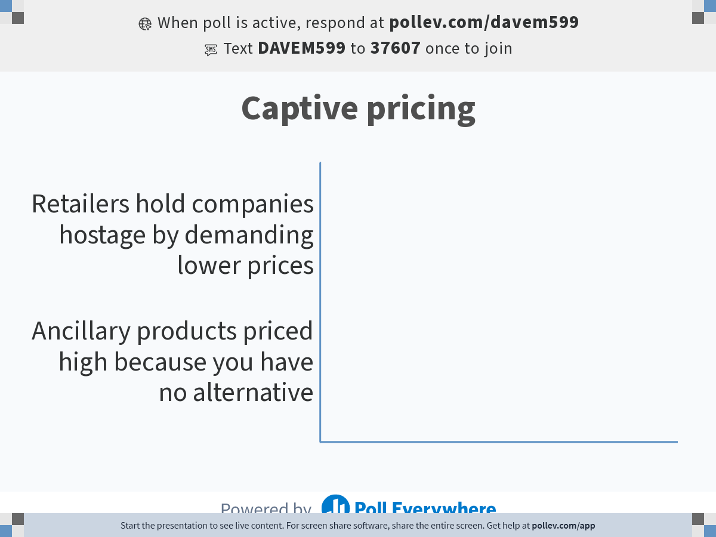
Notes:
Poll Title: Do not modify the notes in this section to avoid tampering with the Poll Everywhere activity.
More info at polleverywhere.com/support
Captive pricing
https://www.polleverywhere.com/multiple_choice_polls/Ilc8JGhBsepbD8JBv0gtY?state=opened&flow=Default&onscreen=persist

Slide 8
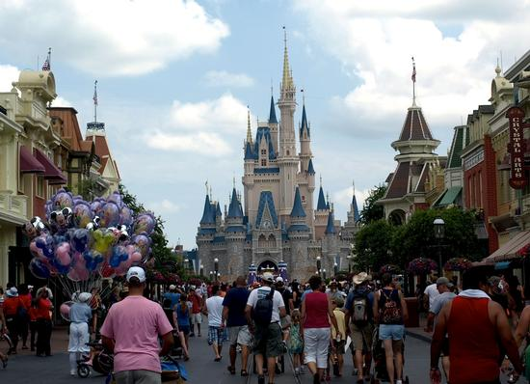
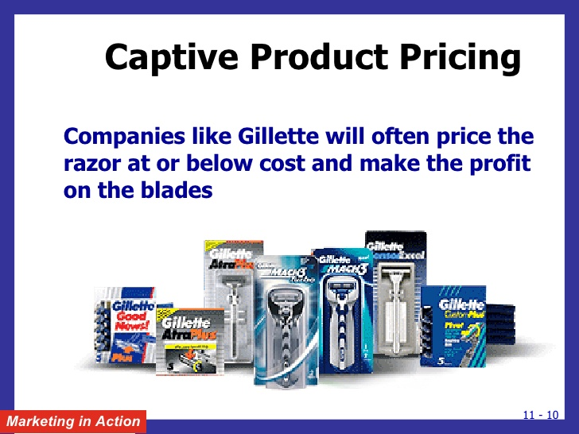
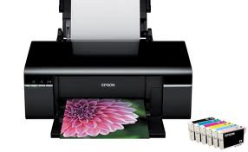
Captive pricing
Ancillary products priced high because you have no alternative

Slide 9
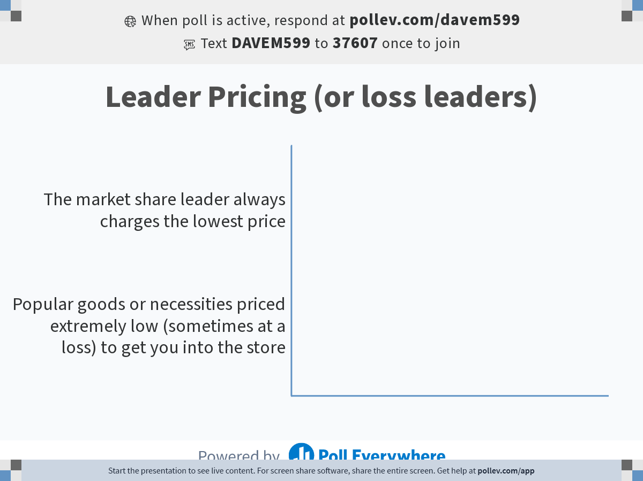
Notes:
Poll Title: Do not modify the notes in this section to avoid tampering with the Poll Everywhere activity.
More info at polleverywhere.com/support
Leader Pricing (or loss leaders)
https://www.polleverywhere.com/multiple_choice_polls/FLglP054QJSYDr5IMbIJv?state=opened&flow=Default&onscreen=persist

Slide 10


Leader Pricing (or loss leaders)
Popular goods or necessities priced extremely low
(sometimes at a loss) to get you into the store
$3.99

Slide 11
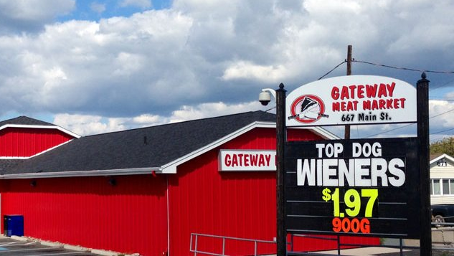

Slide 12
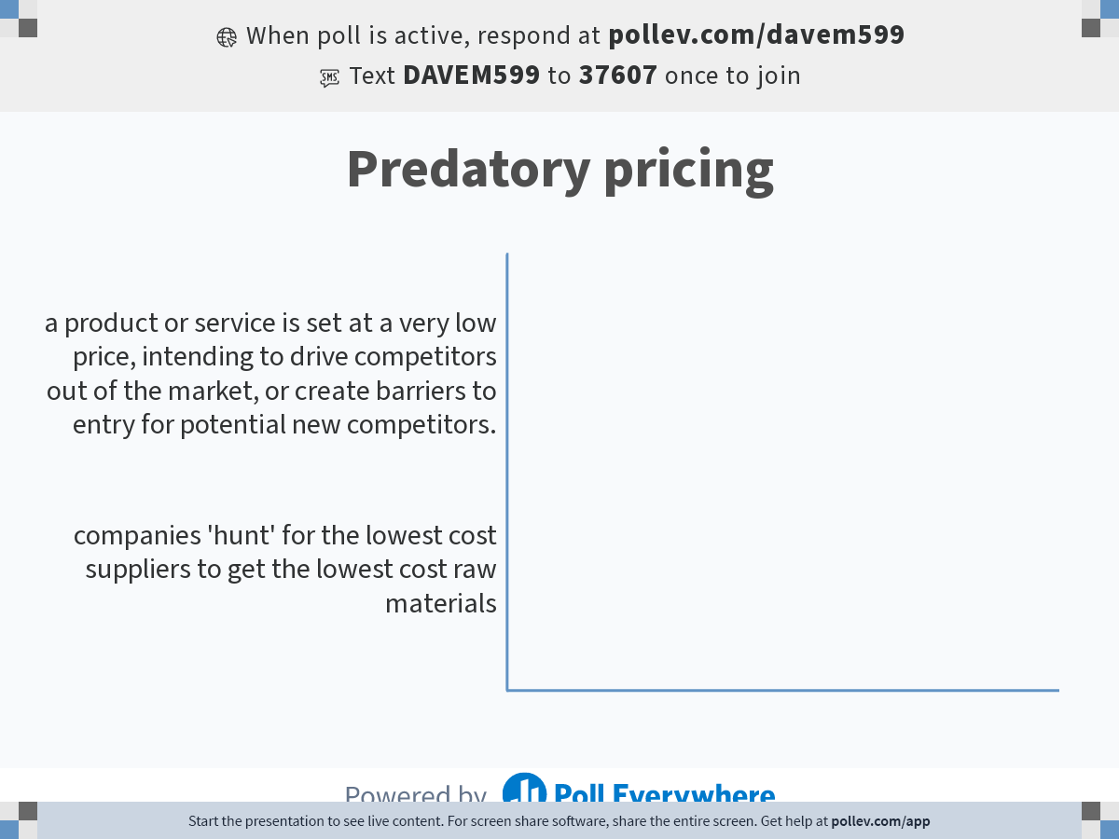
Notes:
Poll Title: Do not modify the notes in this section to avoid tampering with the Poll Everywhere activity.
More info at polleverywhere.com/support
Predatory pricing
https://www.polleverywhere.com/multiple_choice_polls/8UEaUxQ3TweObE59IZWz9?state=opened&flow=Default&onscreen=persist

Slide 13

Predatory pricing
(also undercutting) is a pricing strategy where a product or service is set at a very low price, intending to drive competitors out of the market, or create barriers to entry for potential new competitors.

Slide 14
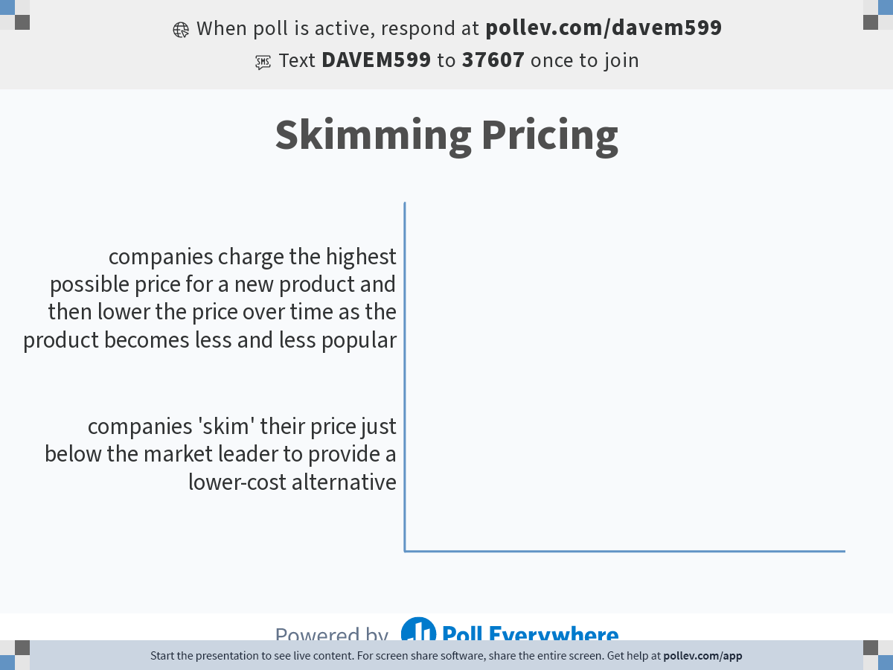
Notes:
Poll Title: Do not modify the notes in this section to avoid tampering with the Poll Everywhere activity.
More info at polleverywhere.com/support
Skimming Pricing
https://www.polleverywhere.com/multiple_choice_polls/IN1WwYxBOaFitsXyjq35s?state=opened&flow=Default&onscreen=persist

Slide 15
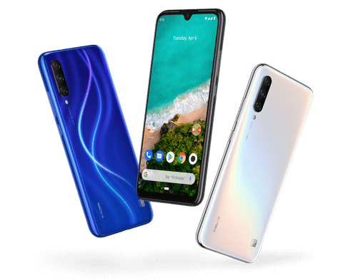
Skimming Pricing
companies charge the highest possible price for a new product and then lower the price over time as the product becomes less and less popular

Slide 16
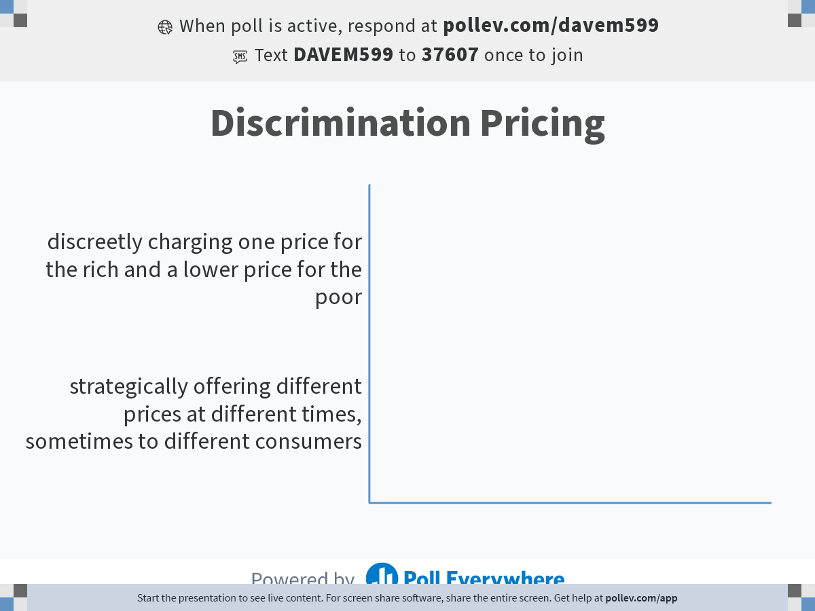
Notes:
Poll Title: Do not modify the notes in this section to avoid tampering with the Poll Everywhere activity.
More info at polleverywhere.com/support
Discrimination Pricing
https://www.polleverywhere.com/multiple_choice_polls/Weds7M3nVRhmP6eneL0Ta?state=opened&flow=Default&onscreen=persist

Slide 17
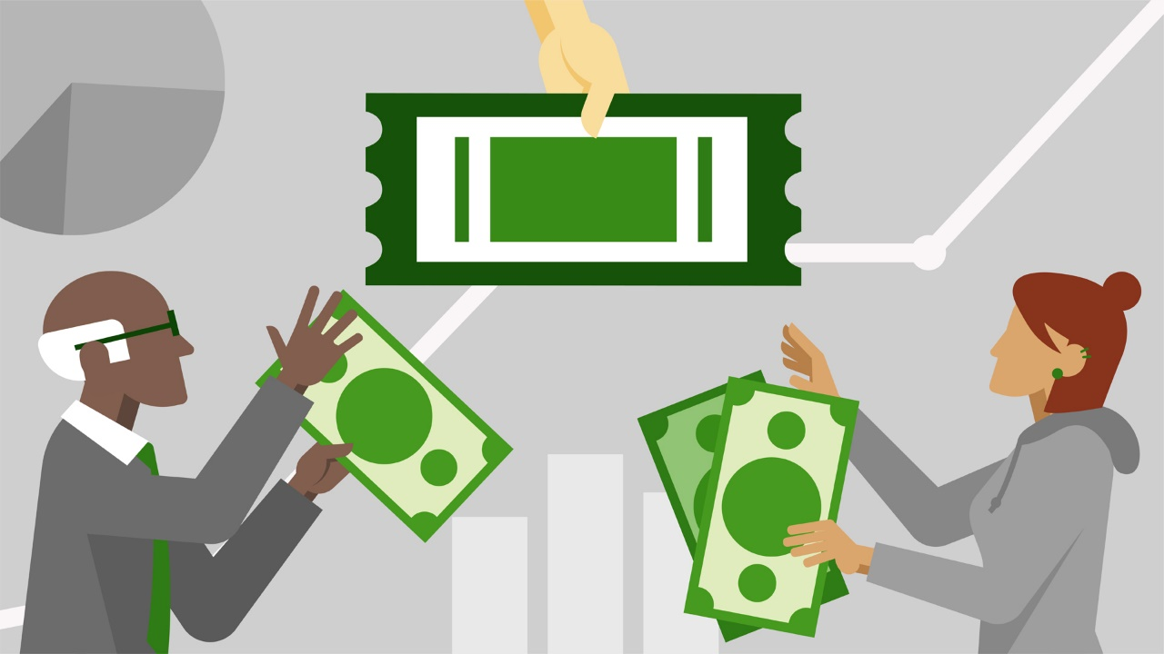
Discrimination Pricing
Strategically offering different prices at different times, sometimes to different consumers
Eg. senior citizen or student discounts, or lower theatre ticket prices on Tuesdays,

Slide 18
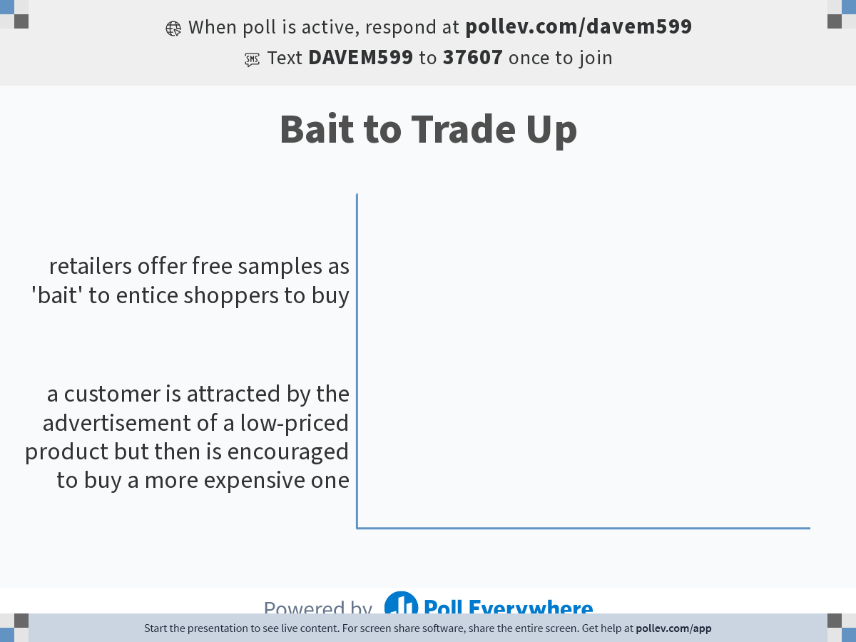
Notes:
Poll Title: Do not modify the notes in this section to avoid tampering with the Poll Everywhere activity.
More info at polleverywhere.com/support
Bait to Trade Up
https://www.polleverywhere.com/multiple_choice_polls/x31BdaR2iu6oYzSIru2jB?state=opened&flow=Default&onscreen=persist

Slide 19
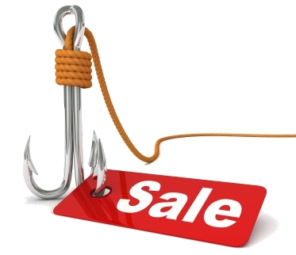
Bait to Trade Up
a customer is attracted by the advertisement of a low-priced product but then is encouraged to buy a more expensive one

Slide 20
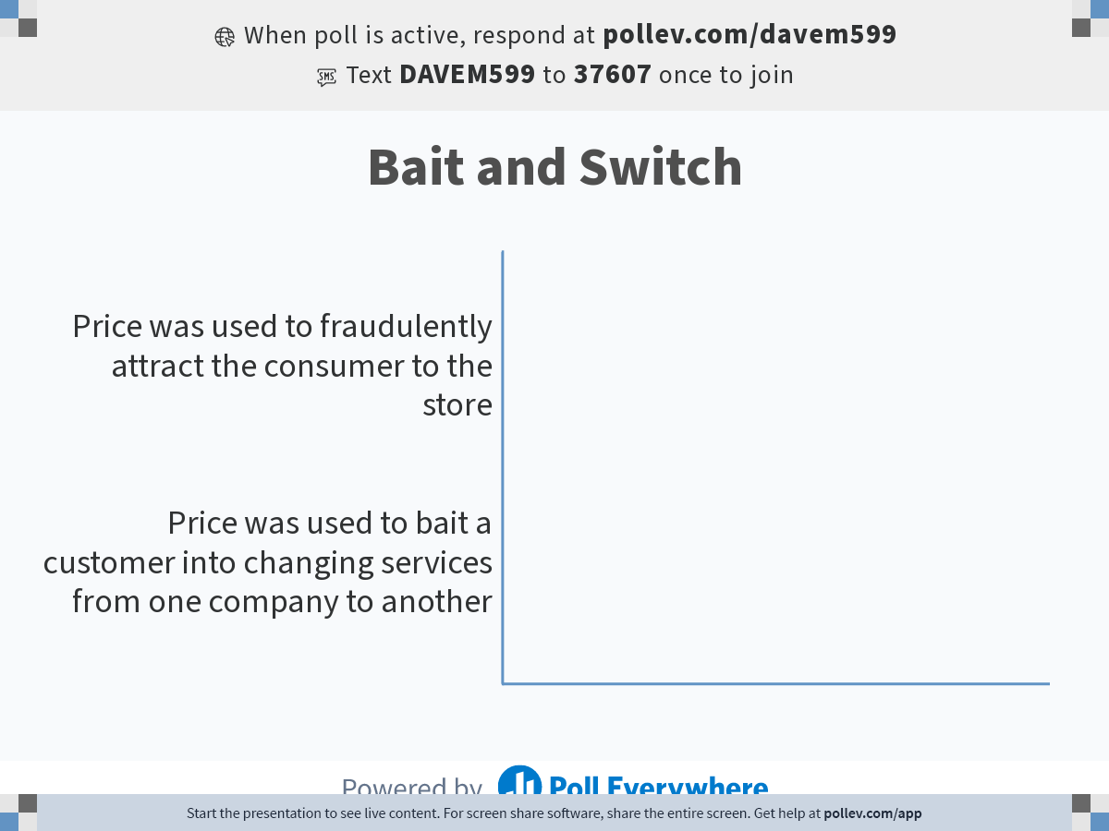
Notes:
Poll Title: Do not modify the notes in this section to avoid tampering with the Poll Everywhere activity.
More info at polleverywhere.com/support
Bait and Switch
https://www.polleverywhere.com/multiple_choice_polls/WSo8ZCI1R6oBhpsW84Jpe?state=opened&flow=Default&onscreen=persist

Slide 21
Bait and Switch
Illegal bait and switch; product
was never actually available.
Price was used to fraudulently attract
the consumer to the store

Slide 22
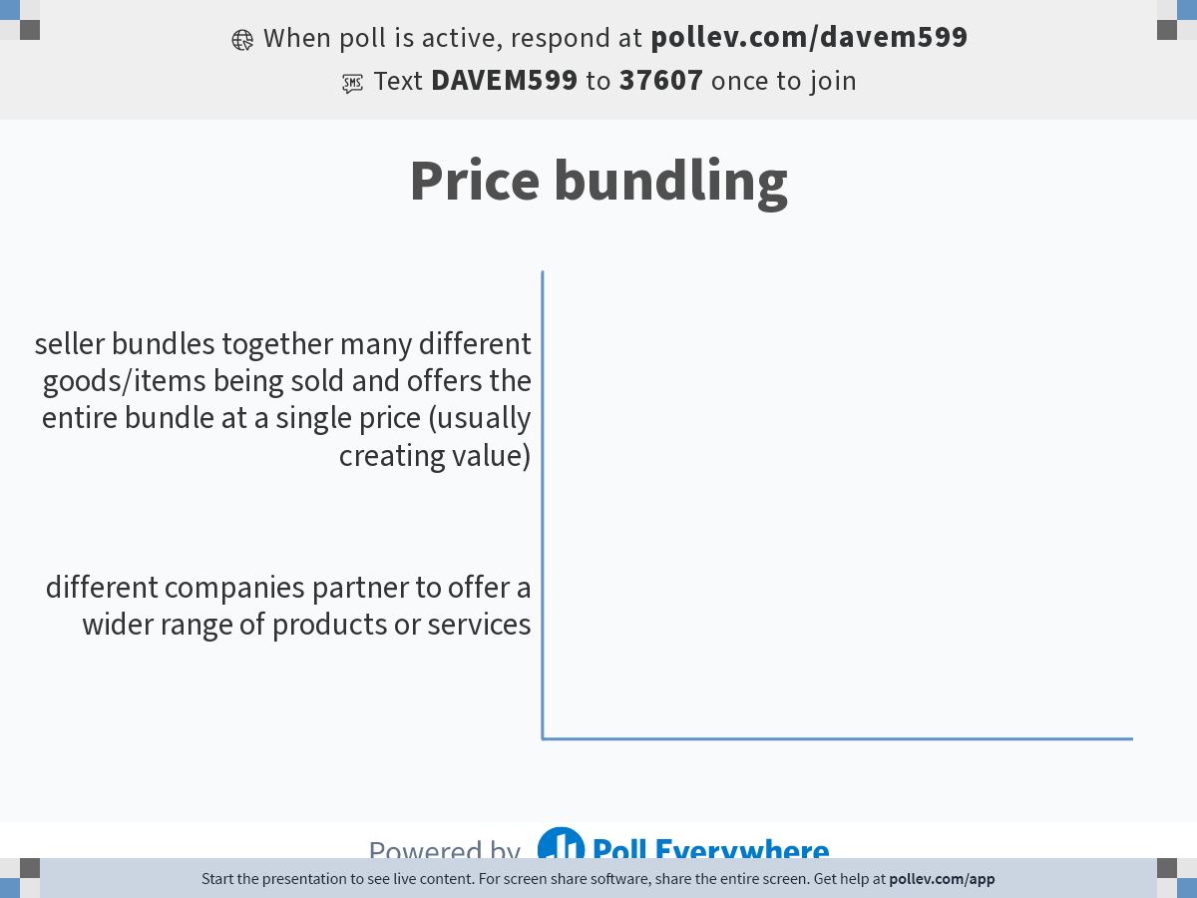
Notes:
Poll Title: Do not modify the notes in this section to avoid tampering with the Poll Everywhere activity.
More info at polleverywhere.com/support
Price bundling
https://www.polleverywhere.com/multiple_choice_polls/5PP5avJjtv5n2rykruZLr?state=opened&flow=Default&onscreen=persist

Slide 23
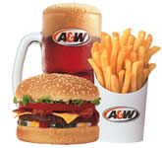
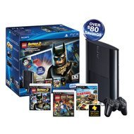
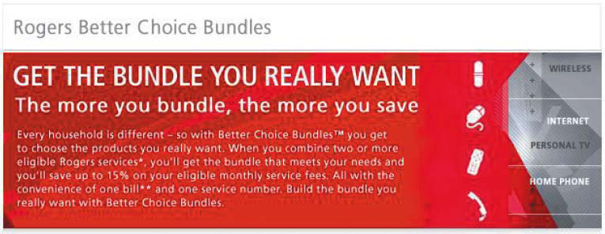
Price bundling
seller bundles together many different goods/items being sold and offers the entire bundle at a single price (usually creating value)

Slide 24
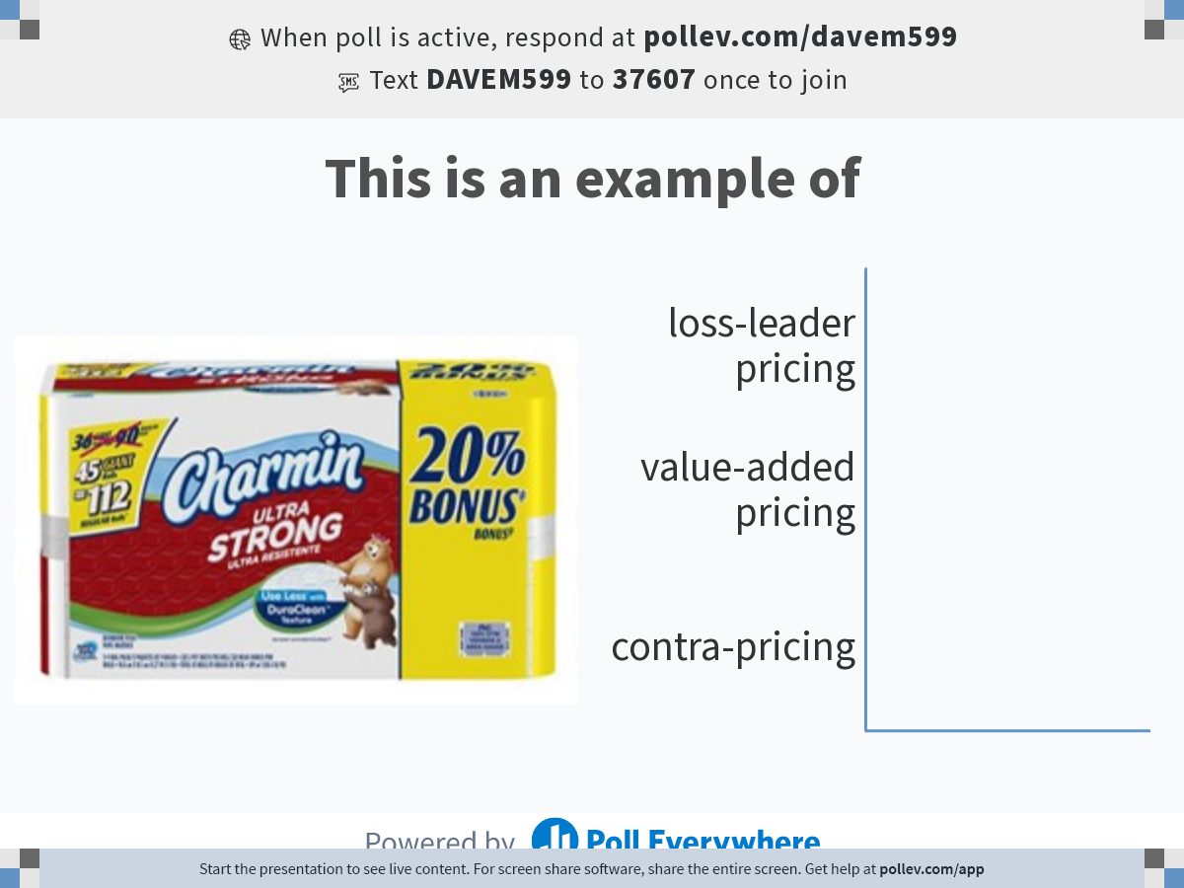
Notes:
Poll Title: Do not modify the notes in this section to avoid tampering with the Poll Everywhere activity.
More info at polleverywhere.com/support
This is an example of
https://www.polleverywhere.com/multiple_choice_polls/p7jRKuXUhG9ppMzdHbT06?state=opened&flow=Default&onscreen=persist

Slide 25
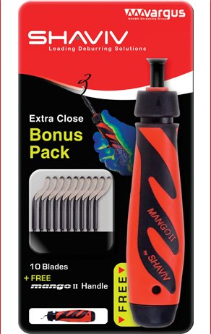
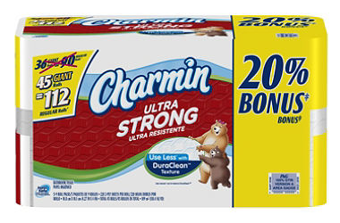
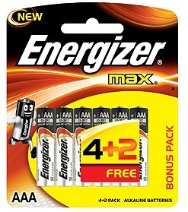
Value Added Pricing
Instead of discounting, manufacturer adds value
to the product

Slide 26
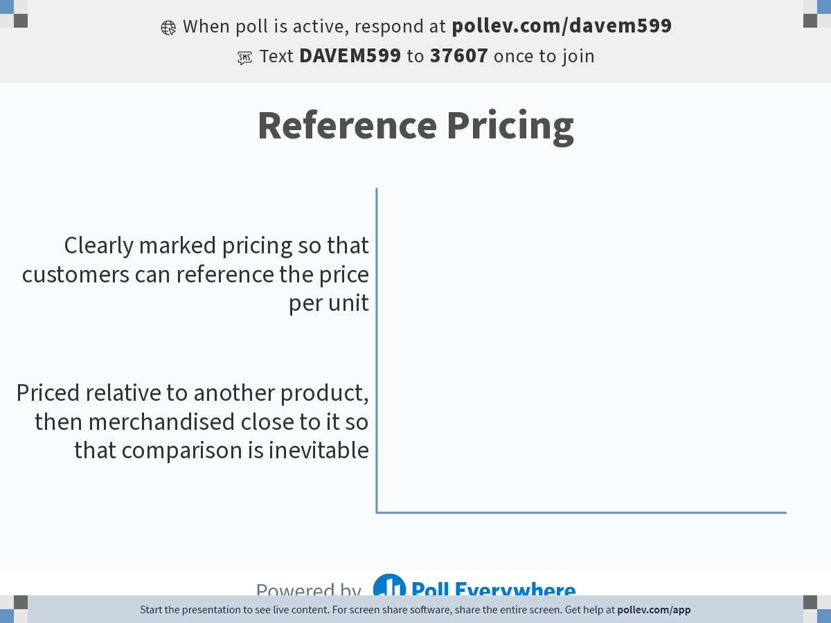
Notes:
Poll Title: Do not modify the notes in this section to avoid tampering with the Poll Everywhere activity.
More info at polleverywhere.com/support
Reference Pricing
https://www.polleverywhere.com/multiple_choice_polls/Ah9OnGGoZKuyTiWbqoBmm?state=opened&flow=Default&onscreen=persist

Slide 27
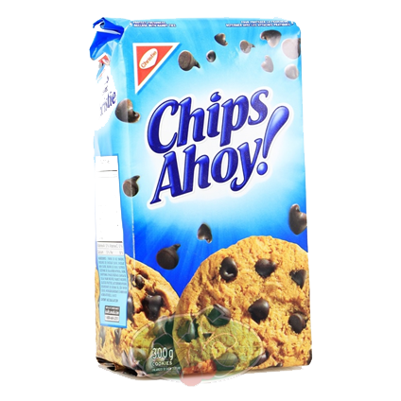
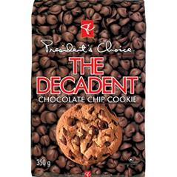
Reference Pricing
Priced relative to another product, then merchandised close to it so that comparison is inevitable

Slide 28
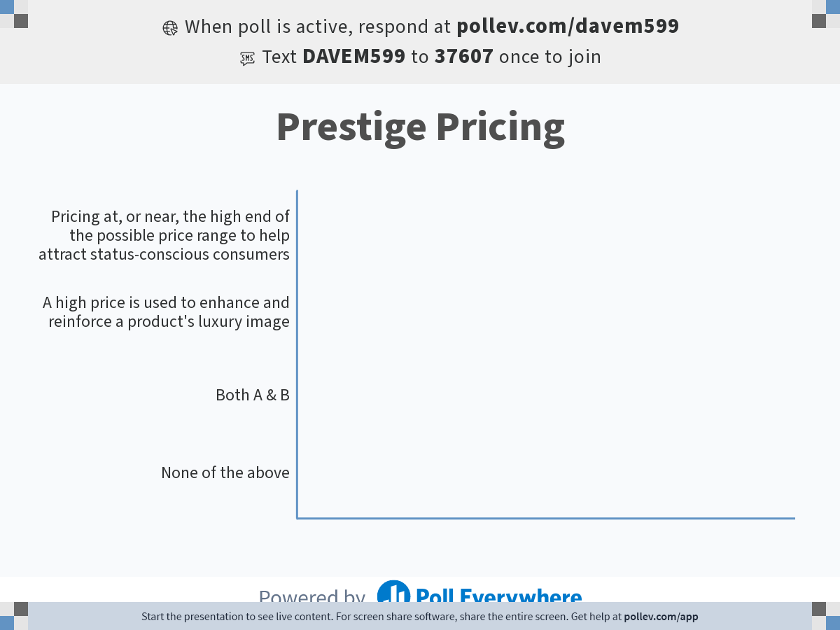
Notes:
Poll Title: Do not modify the notes in this section to avoid tampering with the Poll Everywhere activity.
More info at polleverywhere.com/support
Prestige Pricing
https://www.polleverywhere.com/multiple_choice_polls/nJLkKlKMqwP6imGgGqYRp?state=opened&flow=Default&onscreen=persist

Slide 29


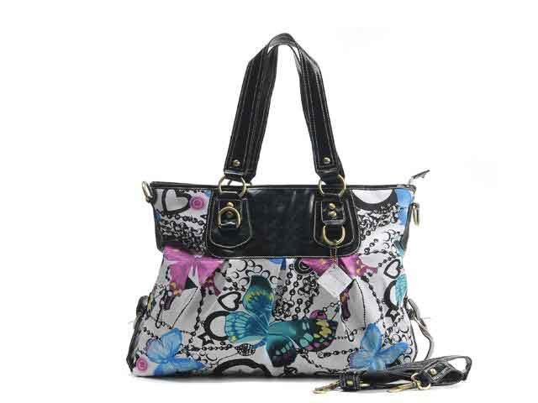
Prestige Pricing
the strategy of consistently pricing at, or near, the high end of the possible price range to help attract status-conscious consumers. The high price is used to enhance and reinforce a product's luxury image.

Slide 30
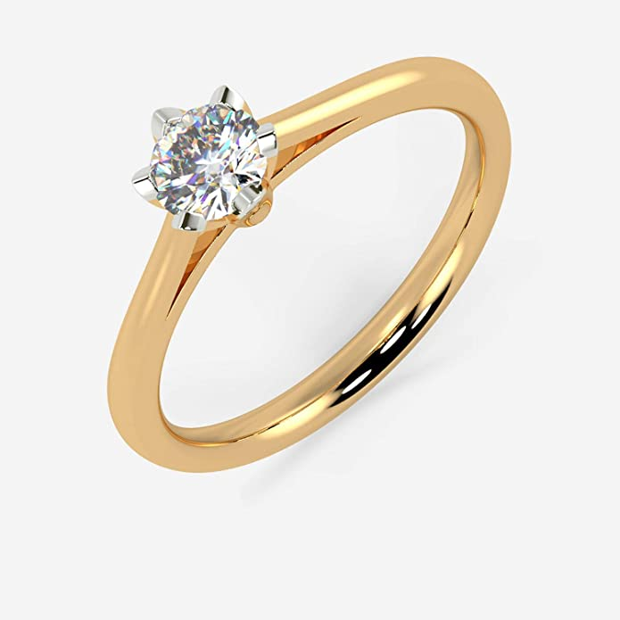
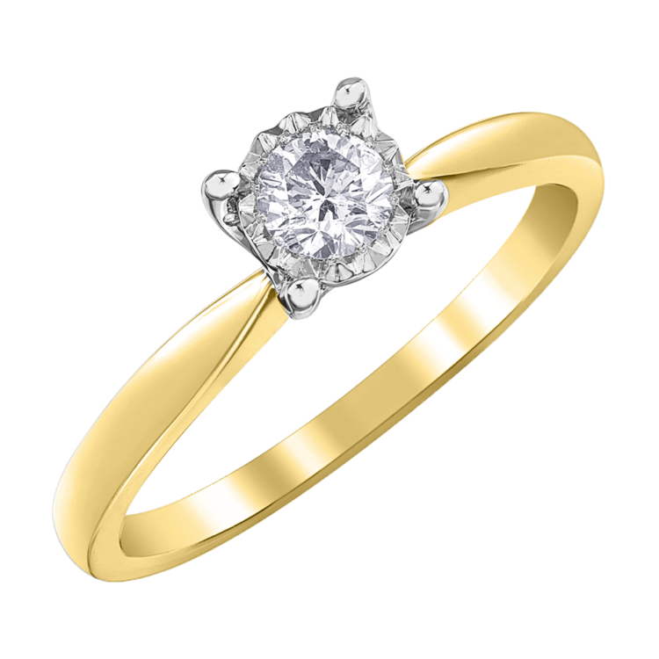
Which ring is higher quality?
$1,500
$25,000

Slide 31
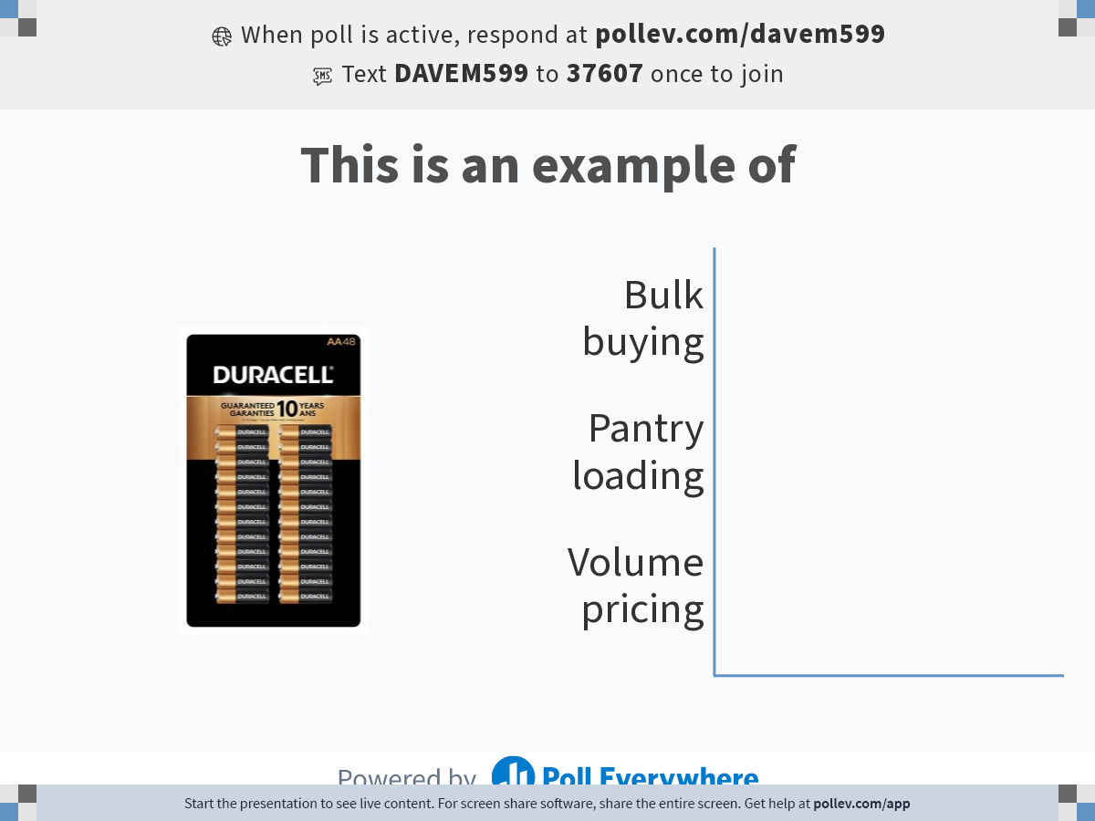
Notes:
Poll Title: Do not modify the notes in this section to avoid tampering with the Poll Everywhere activity.
More info at polleverywhere.com/support
This is an example of
https://www.polleverywhere.com/multiple_choice_polls/WF2XEOadi9fjFraNcaImA?state=opened&flow=Default&onscreen=persist

Slide 32
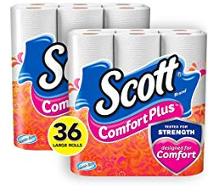
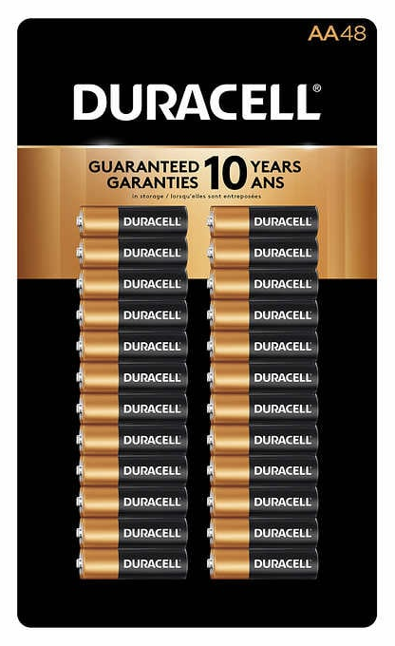
Pantry Loading
is the stockpiling of an item by the consumer taking them out of the market for a while so that they don't shop competitive items

Slide 33
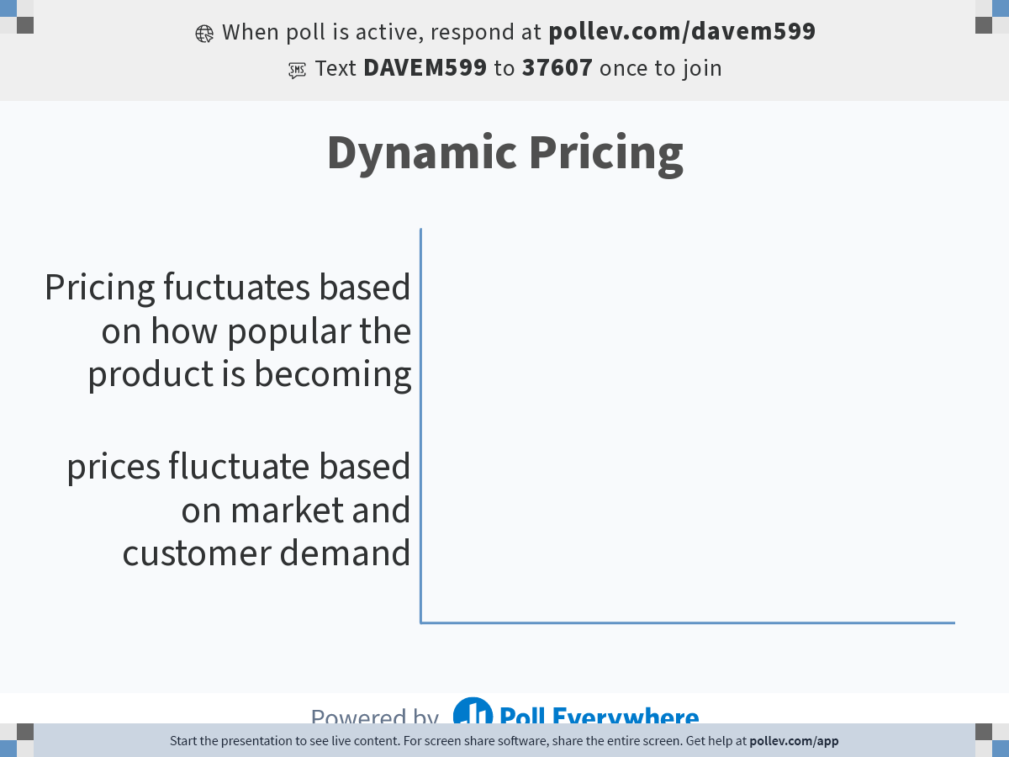
Notes:
Poll Title: Do not modify the notes in this section to avoid tampering with the Poll Everywhere activity.
More info at polleverywhere.com/support
Dynamic Pricing
https://www.polleverywhere.com/multiple_choice_polls/stxFZPXvS9bCmohSWl1Hh?state=opened&flow=Default&onscreen=persist

Slide 34

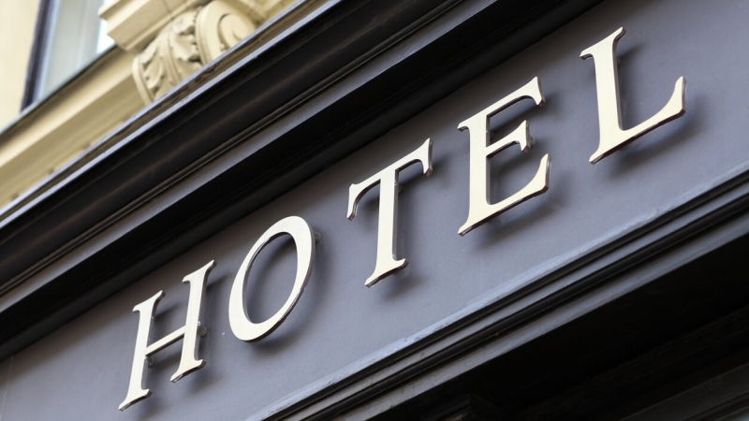
Dynamic Pricing
prices fluctuate based on market and customer demand

Slide 35
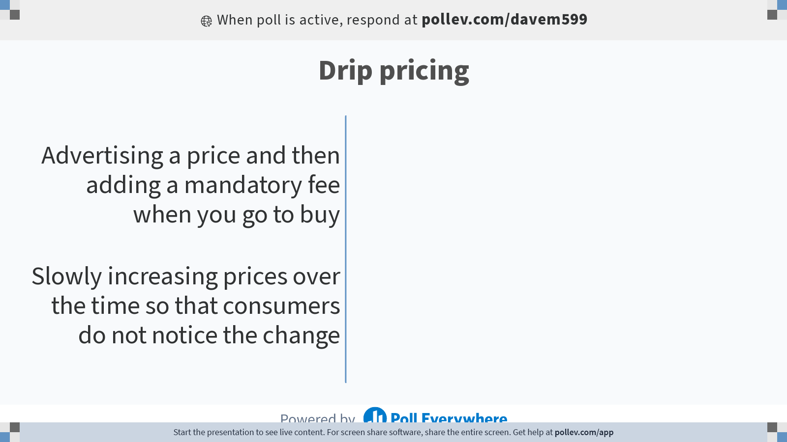
Notes:
Poll Title: Do not modify the notes in this section to avoid tampering with the Poll Everywhere activity.
More info at polleverywhere.com/support
Drip pricing
https://www.polleverywhere.com/multiple_choice_polls/OHRo7yr3G9iSTZkEDiYV2?state=opened&flow=Default&onscreen=persist

Slide 36

Drip Pricing
Advertising a price and then adding a mandatory fee (other than tax)
E.g. adding a mandatory fee to buying a ticket online
Additional charges or fees are false or misleading under the law
The Competition Bureau says
it’s suing Cineplex for allegedly
advertising misleading ticket
prices because of their
mandatory fee

Slide 37


Slide 38
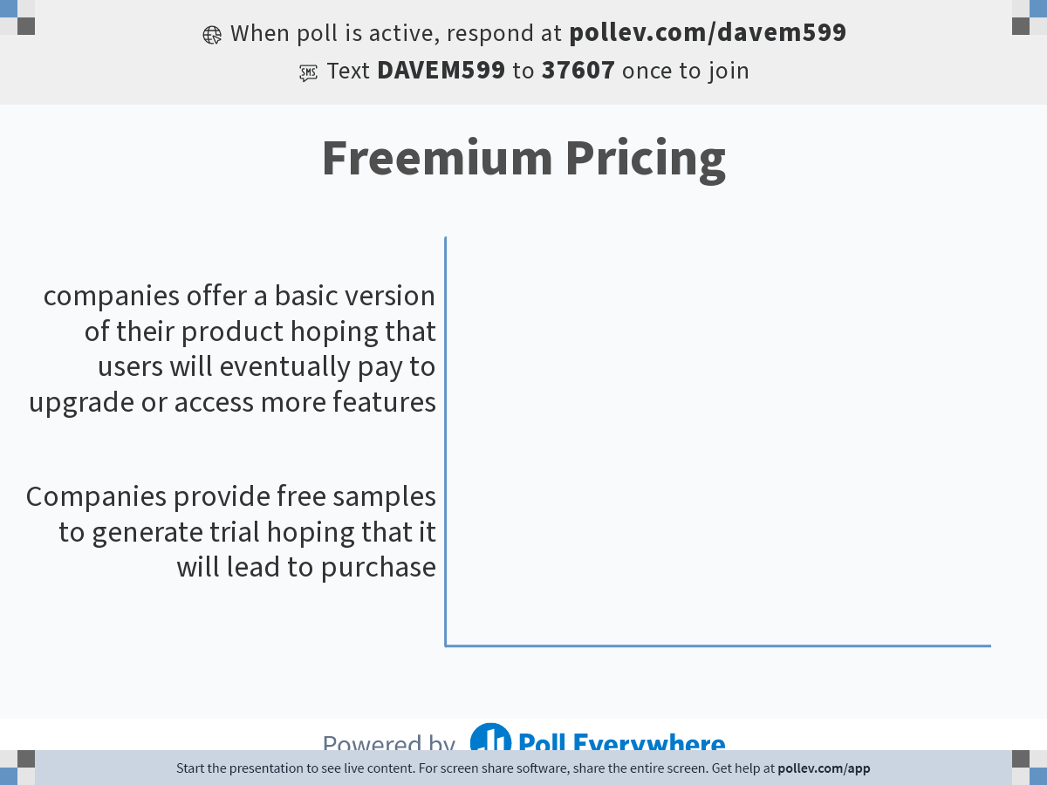
Notes:
Poll Title: Do not modify the notes in this section to avoid tampering with the Poll Everywhere activity.
More info at polleverywhere.com/support
Freemium Pricing
https://www.polleverywhere.com/multiple_choice_polls/oVVBS0UfXz8rPmds62Ssm?state=opened&flow=Default&onscreen=persist

Slide 39


Freemium Pricing
companies offer a basic version of their product hoping that users will eventually pay to upgrade or access more features

Slide 40
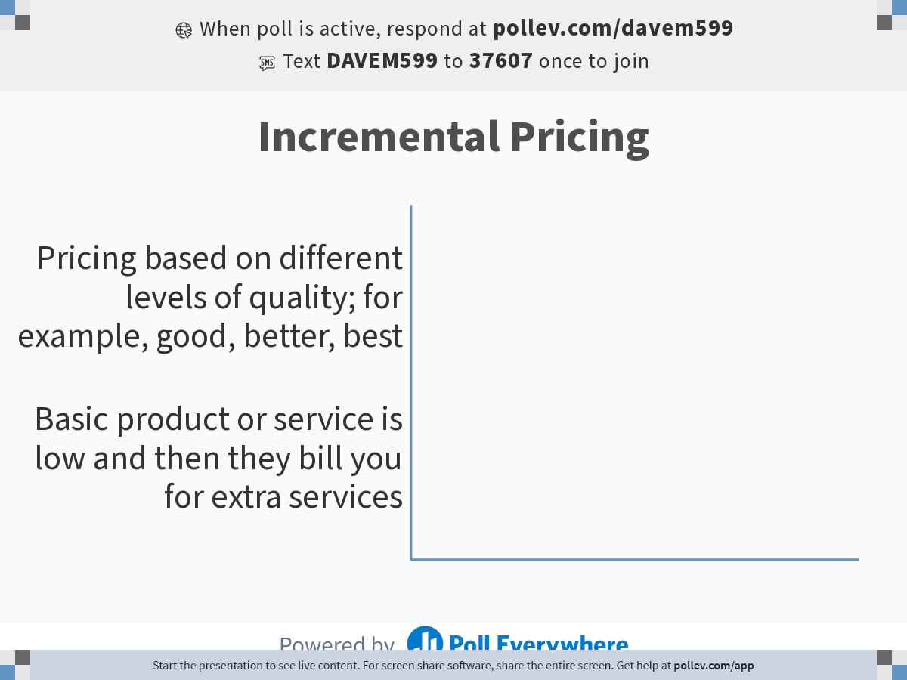
Notes:
Poll Title: Do not modify the notes in this section to avoid tampering with the Poll Everywhere activity.
More info at polleverywhere.com/support
Incremental Pricing
https://www.polleverywhere.com/multiple_choice_polls/OcxyjJAihbhFoR82BqmCV?state=opened&flow=Default&onscreen=persist

Slide 41
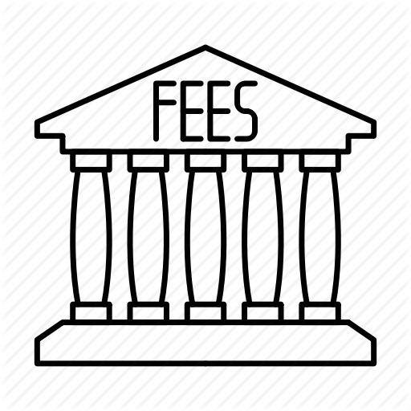
Incremental Pricing
Basic product or service is low and then they bill you for extra services

Slide 42
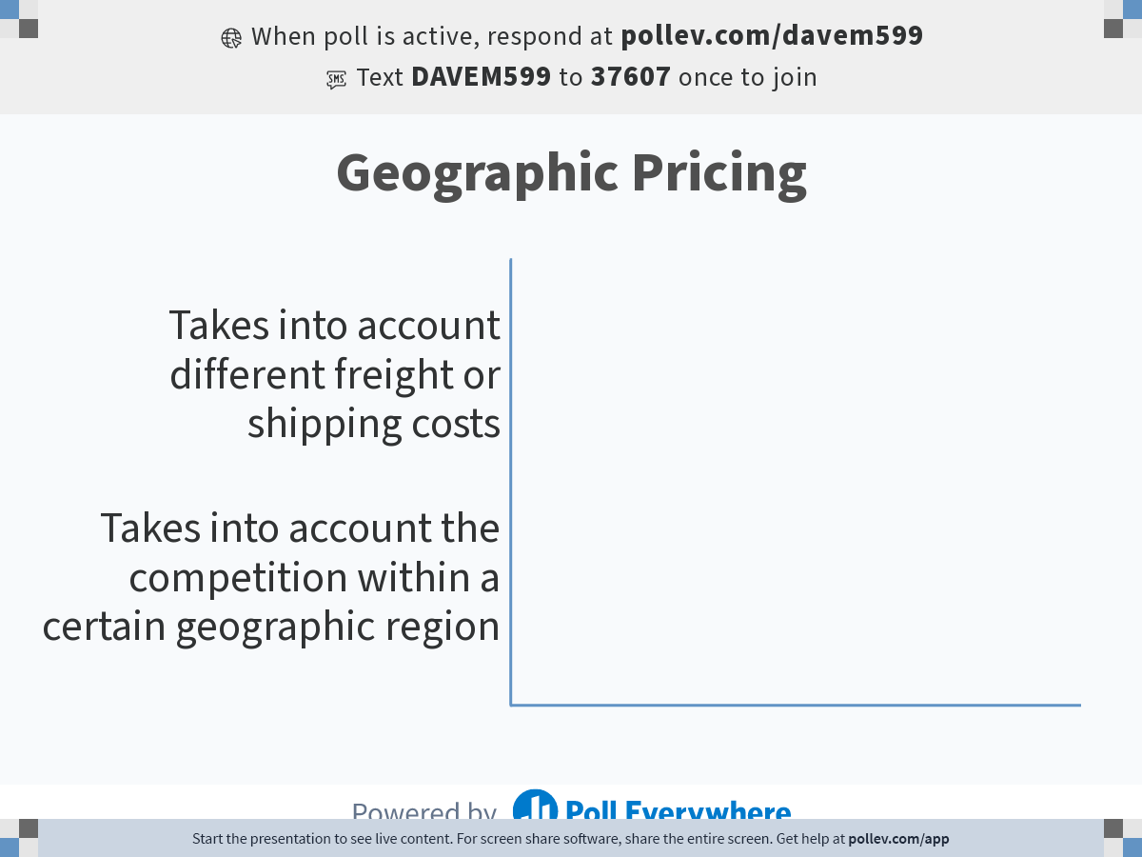
Notes:
Poll Title: Do not modify the notes in this section to avoid tampering with the Poll Everywhere activity.
More info at polleverywhere.com/support
Geographic Pricing
https://www.polleverywhere.com/multiple_choice_polls/MBXTPp5Zs0j3ArKjjfPCP?state=opened&flow=Default&onscreen=persist

Slide 43


Geographic Pricing – Freight issues
Handles cost of freight in different ways
FOB orgin (or factory)
Uniform delivered price
Zone pricing
Freight absorption

Slide 44

PRICE Adjustments
Cash Discounts
Volume Discounts
Member pricing
Seasonal Discounts
Promotional Allowances

