Slide 1
Marketing Objectives &
Considerations

Slide 2
Promotion Objectives
Awareness
  New
  Reminder
Persuade/inform
Trial
Repurchase
  Repeat
  Frequency
Loyalty
Expand my distribution
Recapture lapsed users
Defend against the competition
Expand my product line
Upsell extra products
There can be a wide variety of objectives!

Slide 3
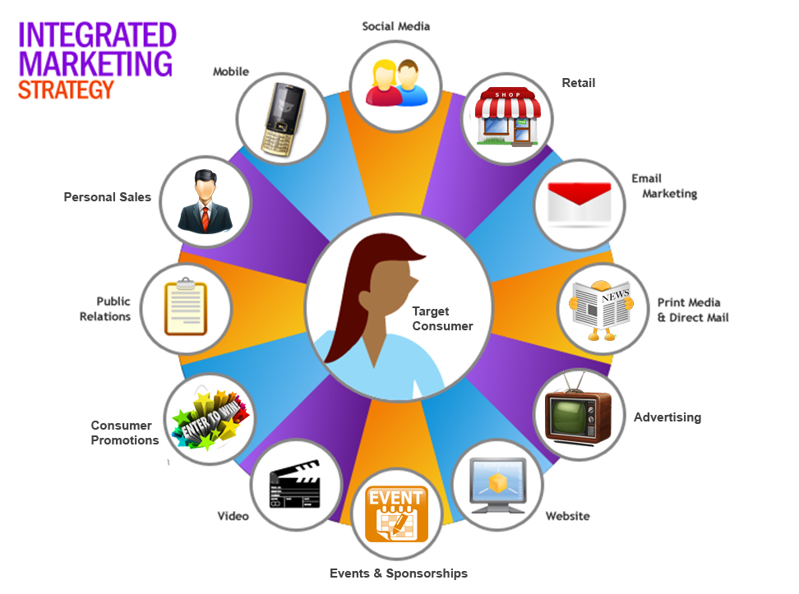
Front
line
Online

Slide 4

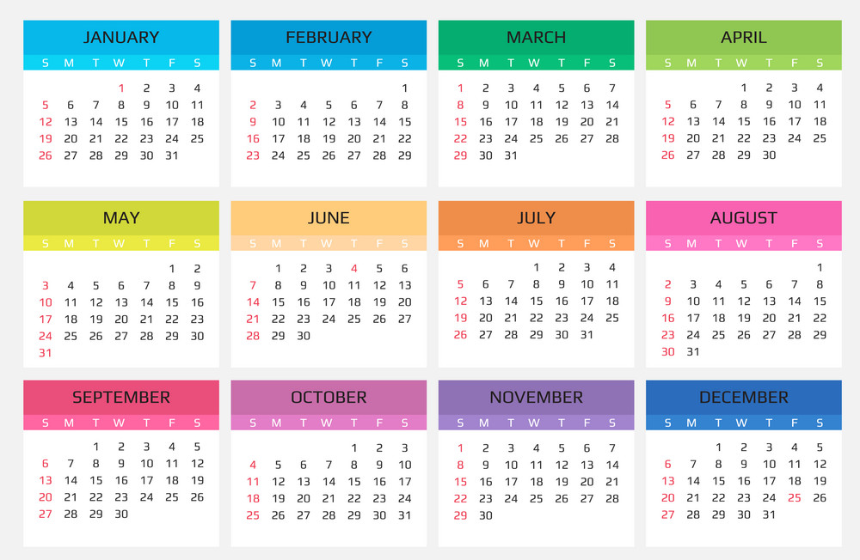
Marketing Planning Considerations

Slide 5
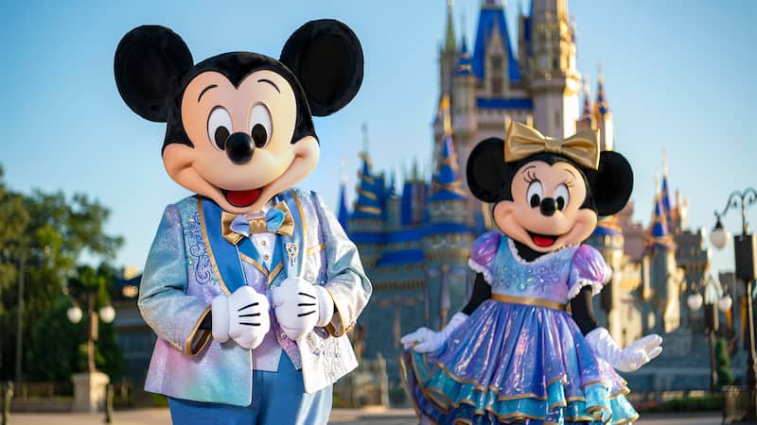
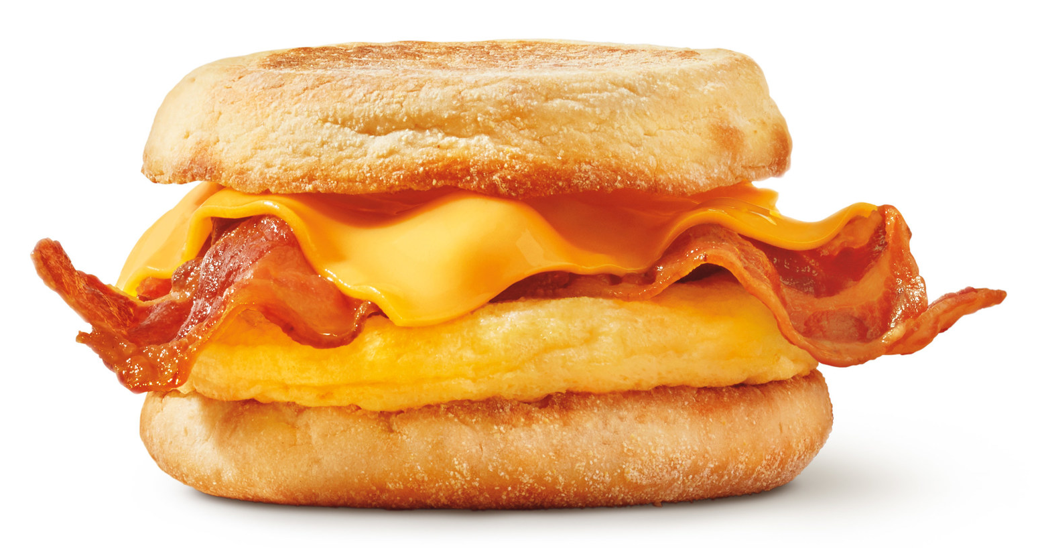





Slide 6

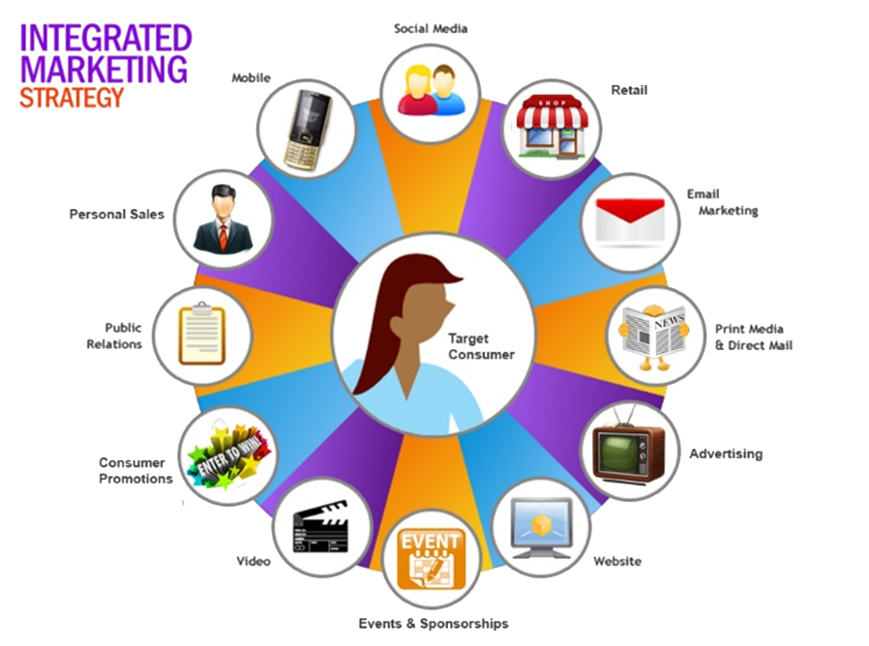
Budget

Slide 7

Does it reach my target market?

Slide 8

Seasonal Considerations

Slide 9
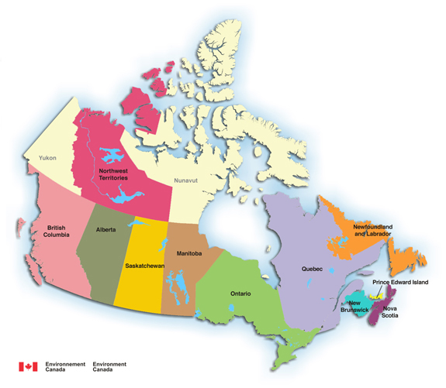
Regional Considerations

Slide 10

Holiday/Event Considerations

Slide 11

Daypart & Weekpart
Considerations

Slide 12

When is the decision made?

Slide 13
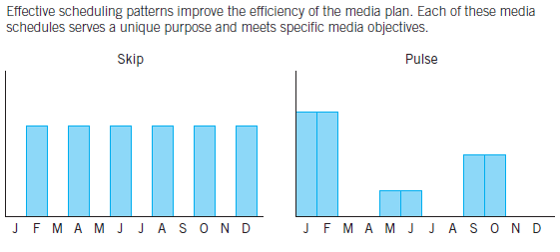
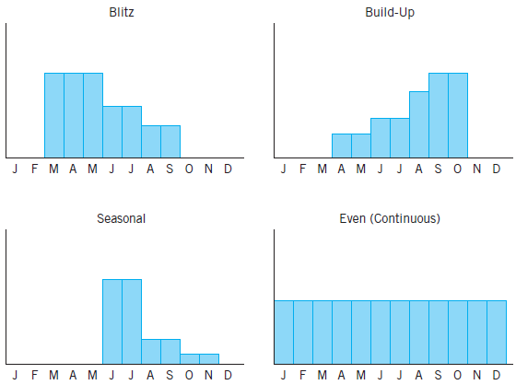
Timing of Advertising & Promotions

Slide 14
Timing of Advertising & Promotions

Slide 15
Timing of Advertising & Promotions

