Slide 1
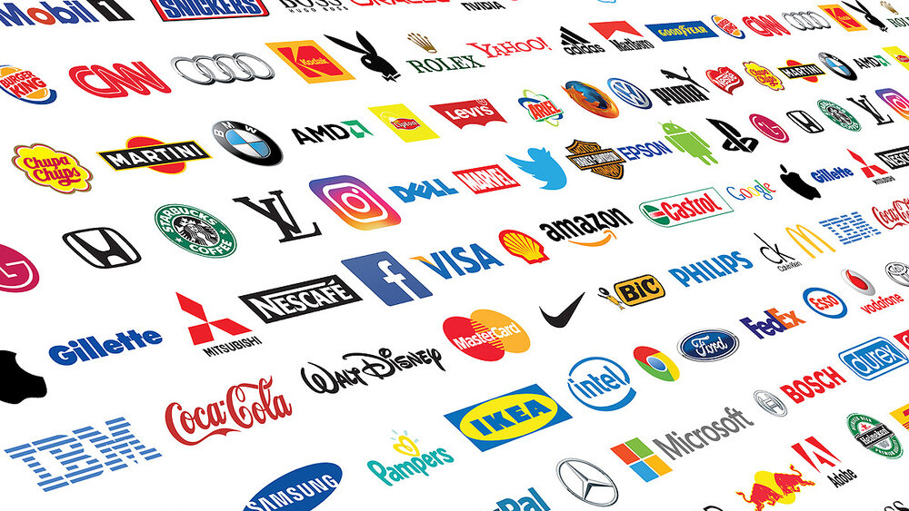
Products and Branding

Slide 2
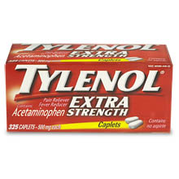
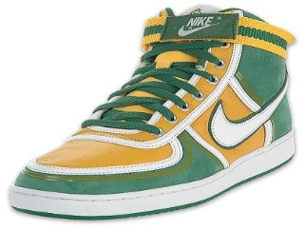
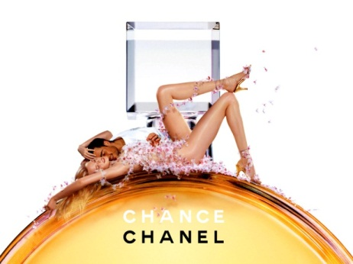
Bringing Buyers and Sellers Together
Marketing

Slide 3
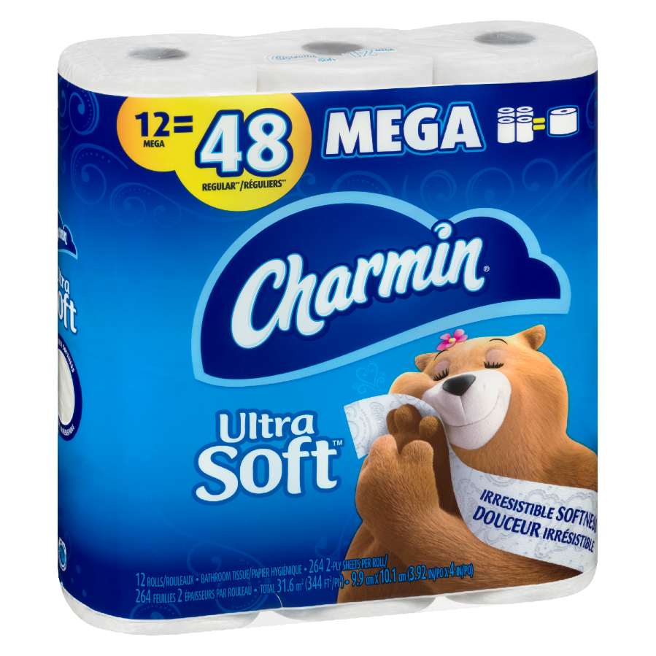
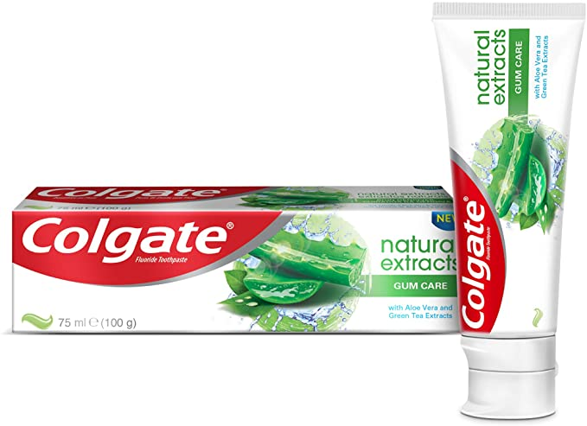
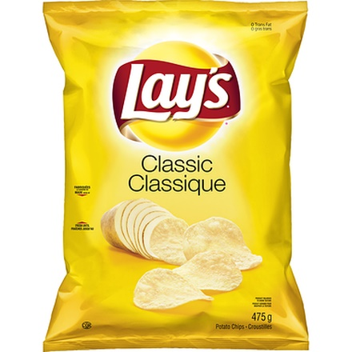
Types of Consumer Products
Low risk & involvement
A Convenience product is relatively inexpensive and merits little shopping effort

Slide 4
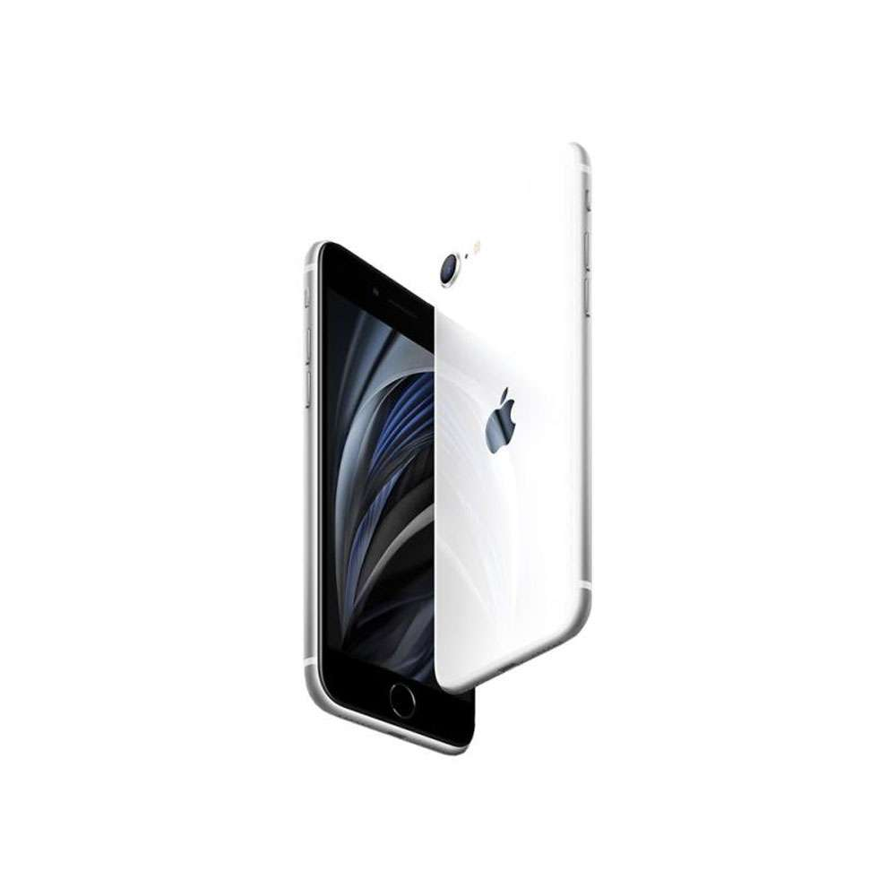
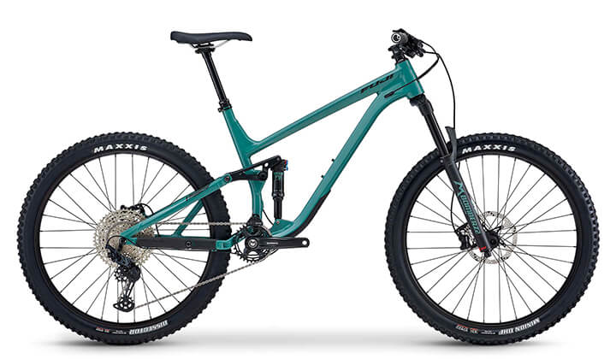
Types of Consumer Products
Moderate risk & involvement
A Shopping product requires some research and comparison because it costs more, and is therefore more risk, than a convenience product

Slide 5
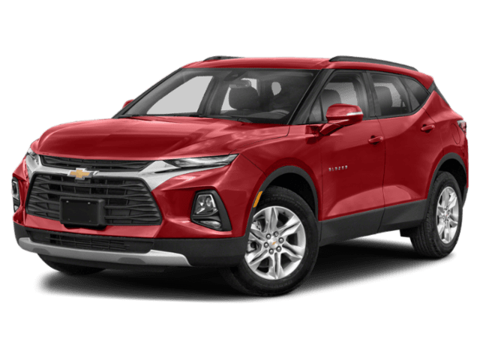
Types of Consumer Products
High risk & involvement
Specialty products require an extensive search and shopping effort generally (but not always) because they are expensive

Slide 6
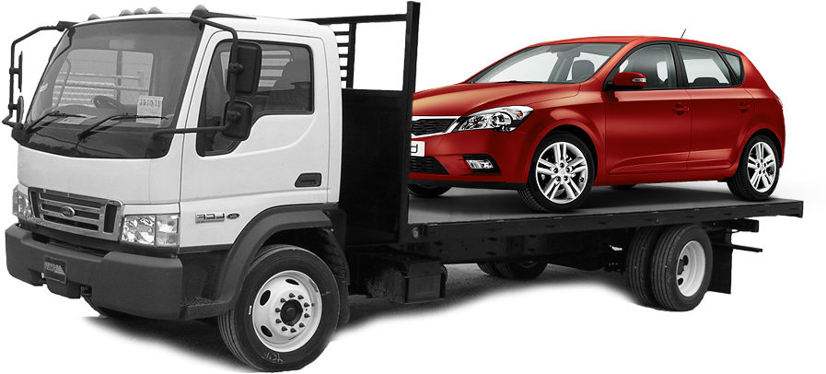
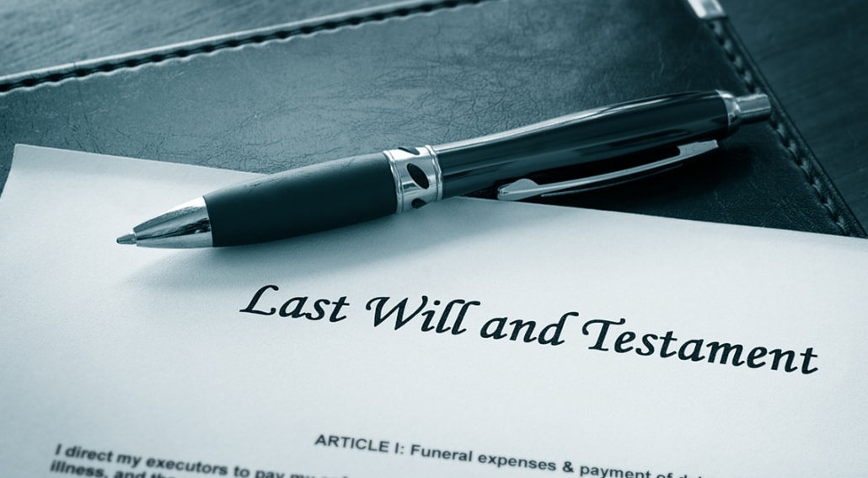
Types of Consumer Products
Unsought products are products that consumers don’t know about, don’t like or don’t actively look for (needs!)

Slide 7
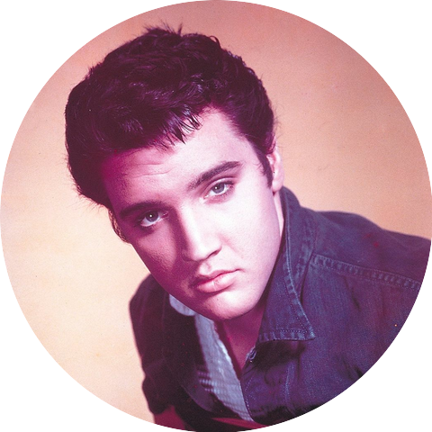
Others…
Organizations
Persons
Places
Ideas

Slide 8
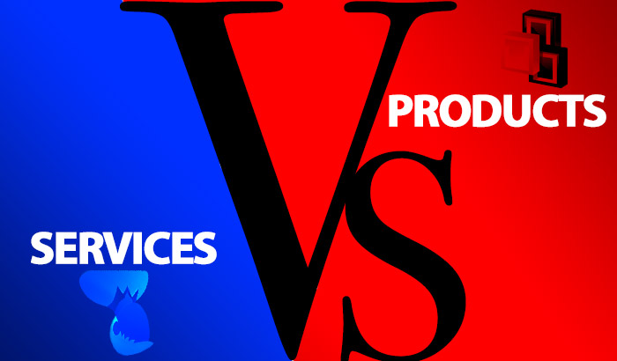
Products vs Services

Slide 9
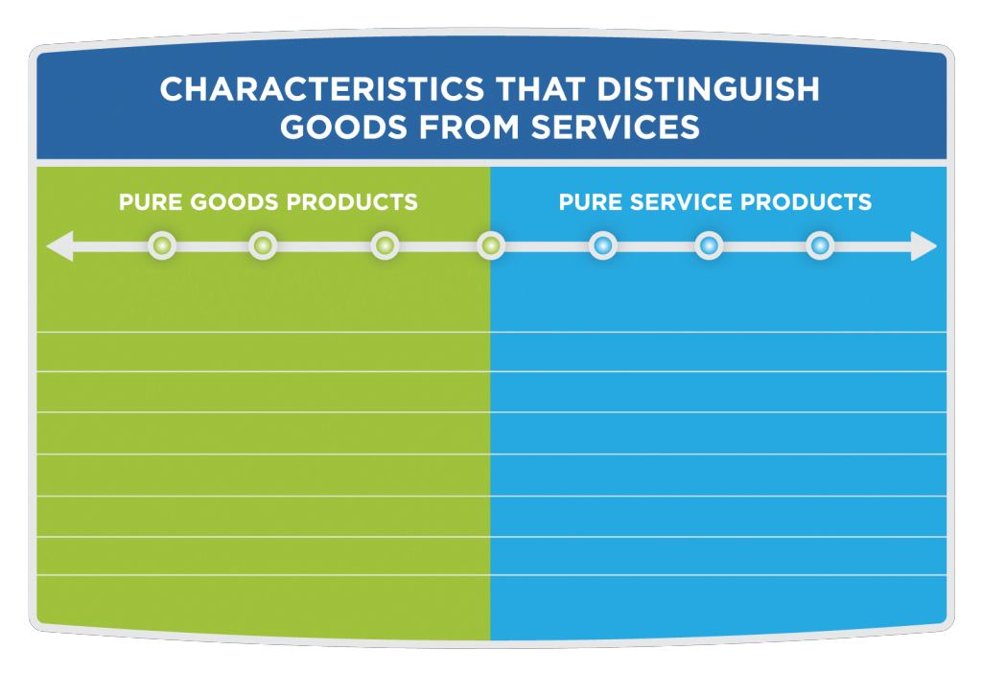
Appliances
Restaurants
Car repairs
Legal
Smartphone
Air travel
Haircut
Tangible
Intangible
Can be stored (inventory)
Perishable and time sensitive
Pre-produced
Produced & consumed at the same time
Evaluated on physical properties
Evaluated on quality of service
Long ownership
Consumed and can’t be owned
Not customized
Often customized
Manufactured under controlled conditions
Labour intensive, inconsistent

Slide 10
Principles of marketing are the same

Slide 11
A Brand
Features used to create an identity
An ideal brand motivates consumers and differentiates your brand from the competition
They are used to shape perceptions in the minds of consumers
Includes facts AND imagery

Slide 12
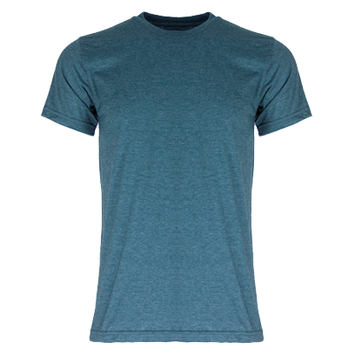
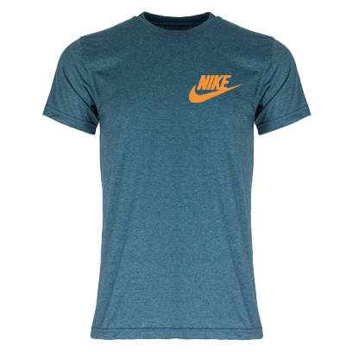
$20
$50

Slide 13
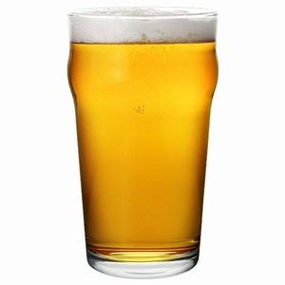
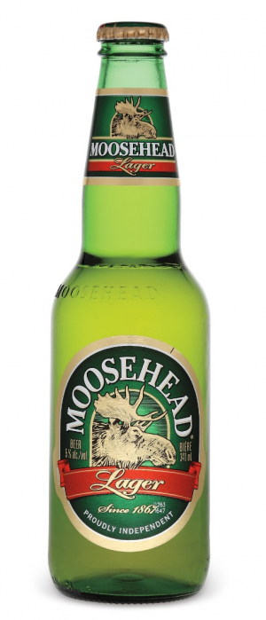
Brand Taste Test

Slide 14
Blind Taste Test

Slide 15
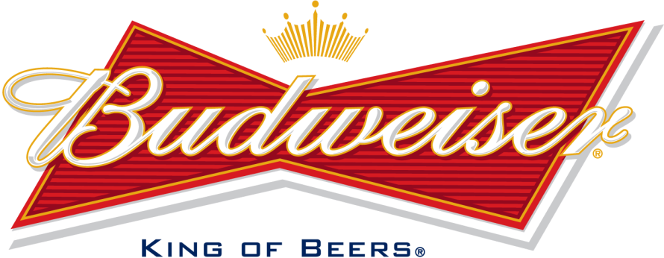
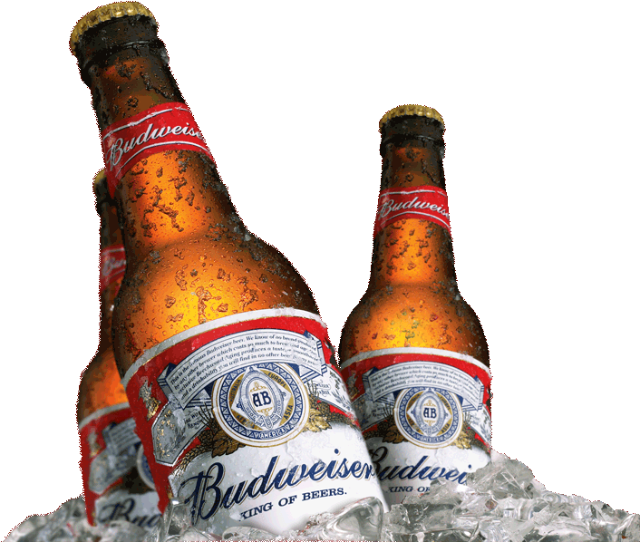
Product vs Brand

Slide 16
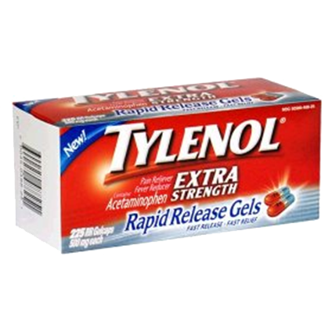
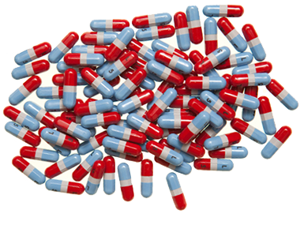
The Product
The Brand

Slide 17
Brand Profile
The Product is... | The physical description of the product or service

Slide 18
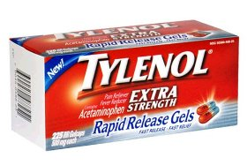
Tylenol
The Product is... | Acetaminophen gel tablets

Slide 19
Brand Profile
The Product is... | The physical description of the product or service.
The Tangible Benefit is... | The rational benefit or core function of the product or service.

Slide 20
Tylenol
The Product is... | Acetaminophen gel tablets
The Tangible Benefit is... | Alleviates headache pain

Slide 21
Brand Profile
The Product is... | The physical description of the product or service.
The Tangible Benefit is... | The rational benefit or core function of the product or service.
The Emotional Link is... | Most brands elicit an emotional response, which can be a very powerful motivator.

Slide 22
Tylenol
The Product is... | Acetaminophen gel tablets
The Tangible Benefit is... | Alleviates headache pain
The Emotional Link is... | You can enjoy life and do more when you are free of pain

Slide 23
Brand Profile
The Product is... | The physical description of the product or service.
The Tangible Benefit is... | The rational benefit or core function of the product or service.
The Emotional Link is... | Most brands elicit an emotional response, which can be a very powerful motivator.
Image and Values are... | Brands develop an image with personality and character to complement its tangible benefits and emotional links.

Slide 24
Tylenol
The Product is... | Acetaminophen gel tablets
The Tangible Benefit is... | Alleviates headache pain
The Emotional Link is... | You can enjoy life and do more when you are free of pain
Image and Values are... | Caring, joyful, uplifting, trusted
USP

Slide 25
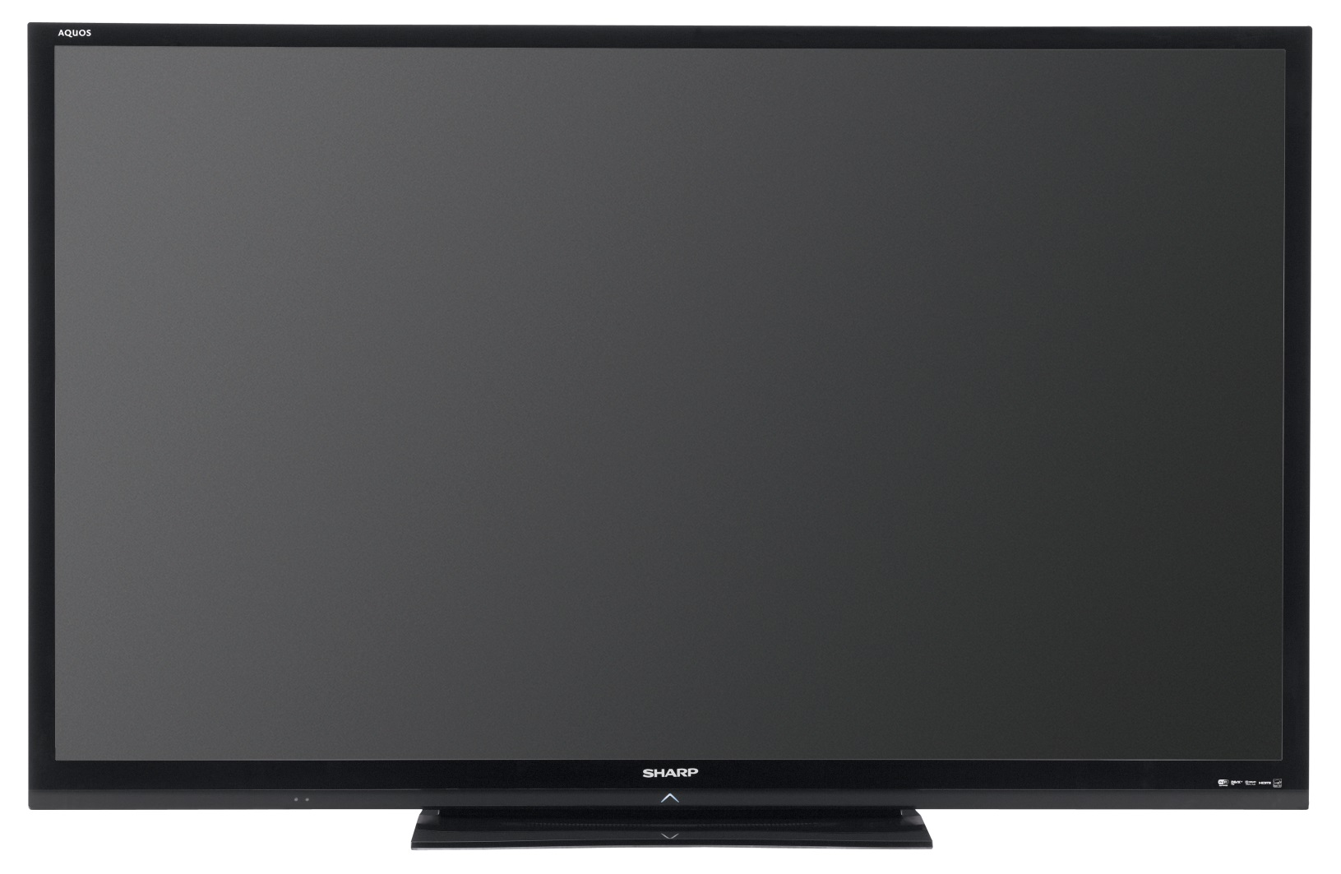
Whatever your normal is

Slide 26
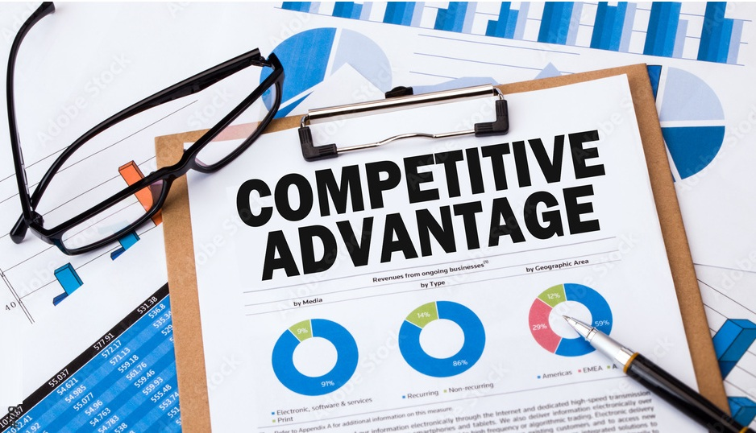

Slide 27
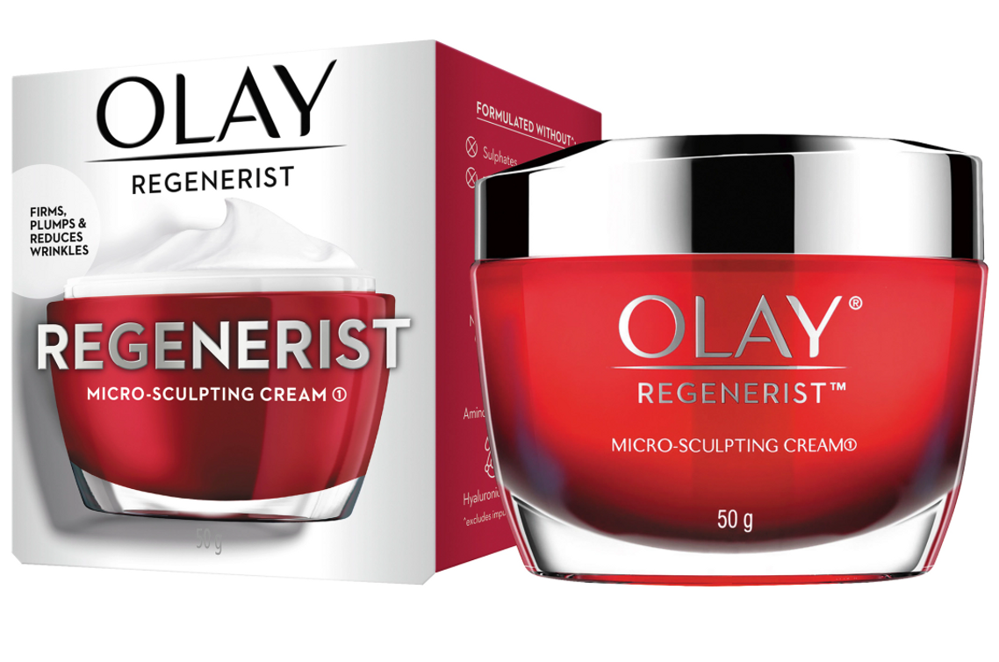

Slide 28
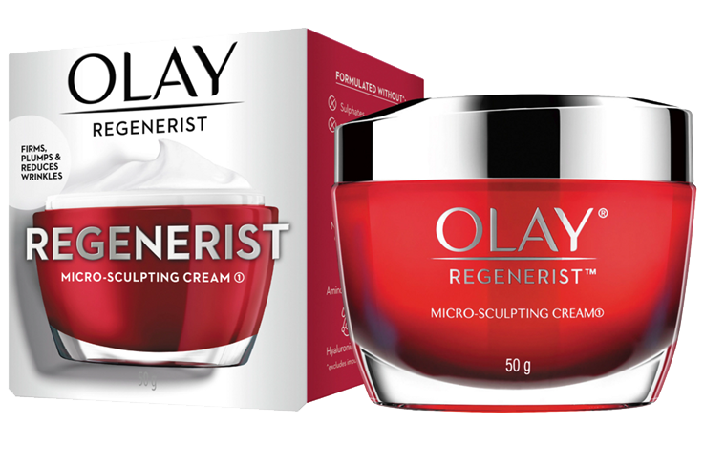
The Product is... | Anti-aging moisturizing cream
The Tangible Benefit is... | Accelerates surface cell regeneration so you wake up to intensely moisturized skin. Continuously moisturizes throughout the night to reduce the appearance of fine lines and wrinkles.
The Emotional Link is... | Look and feel younger. The secret to eternal youth!
Image and Values are... | Miracle worker! Scientific. Caring.

Slide 29
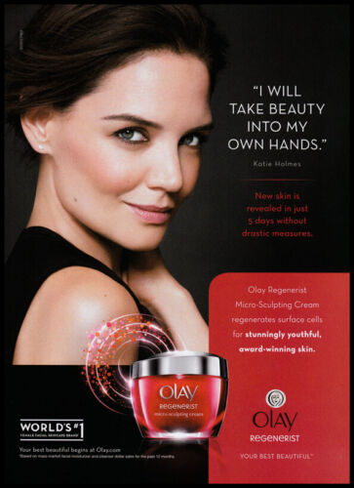
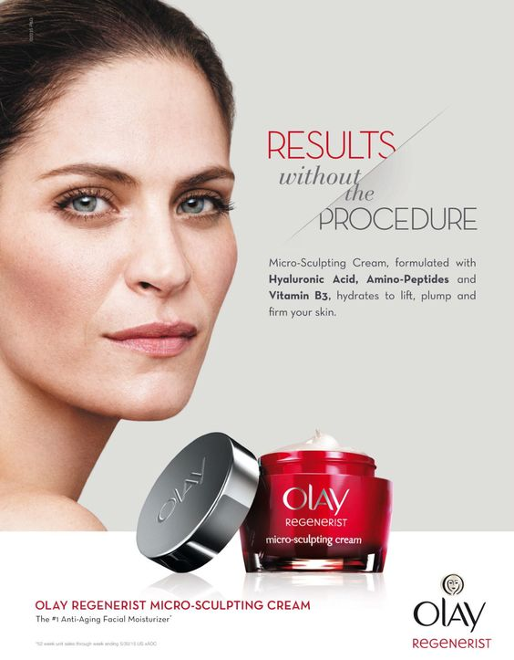
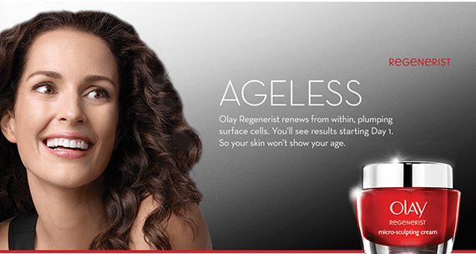

Slide 31
The Product is... | Department store featuring a wide variety of quality merchandise at very competitive prices.
The Tangible Benefit is... | By offering the best in value, consumers pay less for essential items and have more money left over for luxury items.
The Emotional Link is... | Life is so much better when your limited income buys more for you and your family.
Image and Values are... | Thrifty, conscientious, responsible, smart.

Slide 32
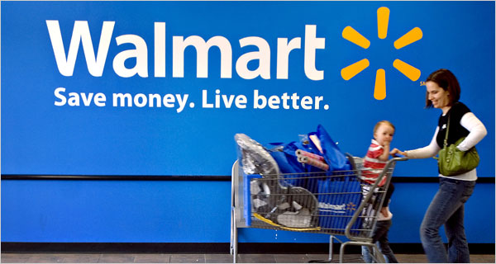
On Sept. 12, Wal-Mart introduces new ads with the slogan "Save Money. Live Better" replacing "Always Low Prices," which it had used for the previous 19 years. Marketers see the shift as an attempt to go beyond the rational appeal of low prices and forge an emotional bond with consumers.

Slide 33
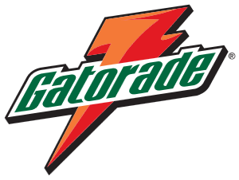

Slide 34
Gatorade
The Product is... | Formulated sports drink with carbohydrates and electrolytes
The Tangible Benefit is... | Electrolytes keep the body hydrated during exercise, and carbohydrates increase blood sugar which the body burns as energy.
The Emotional Link is... | By staying hydrated, Gatorade will ensure that you are performing at your highest level.
Image and Values are... | Proud, competitive, hard working.

Slide 35
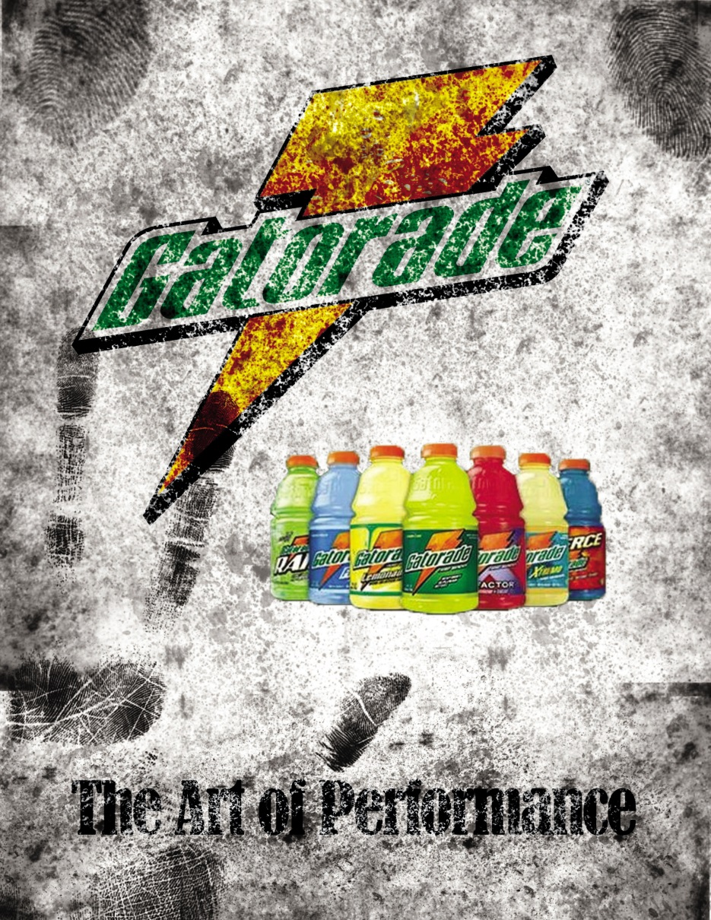

Slide 38
Michelin
The Product is... | Engineered tires
The Tangible Benefit is... | Excellent traction and control while you are driving. Stop on a dime!
The Emotional Link is... | The safety of Michelin tires will protect the family that you love so dearly.
Image and Values are... | Caring, secure, strong, protective

Slide 40
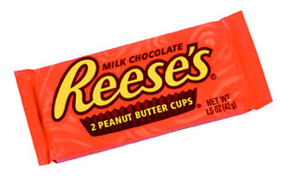
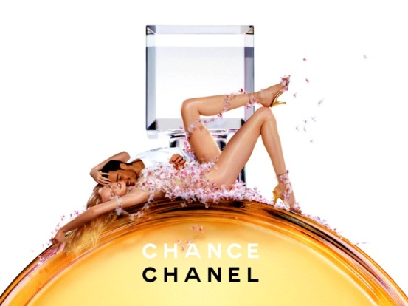
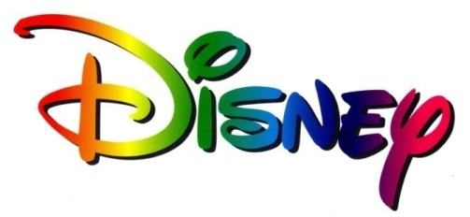
Product emphasis
Benefits emphasis
Image emphasis
Emotional emphasis

Slide 42
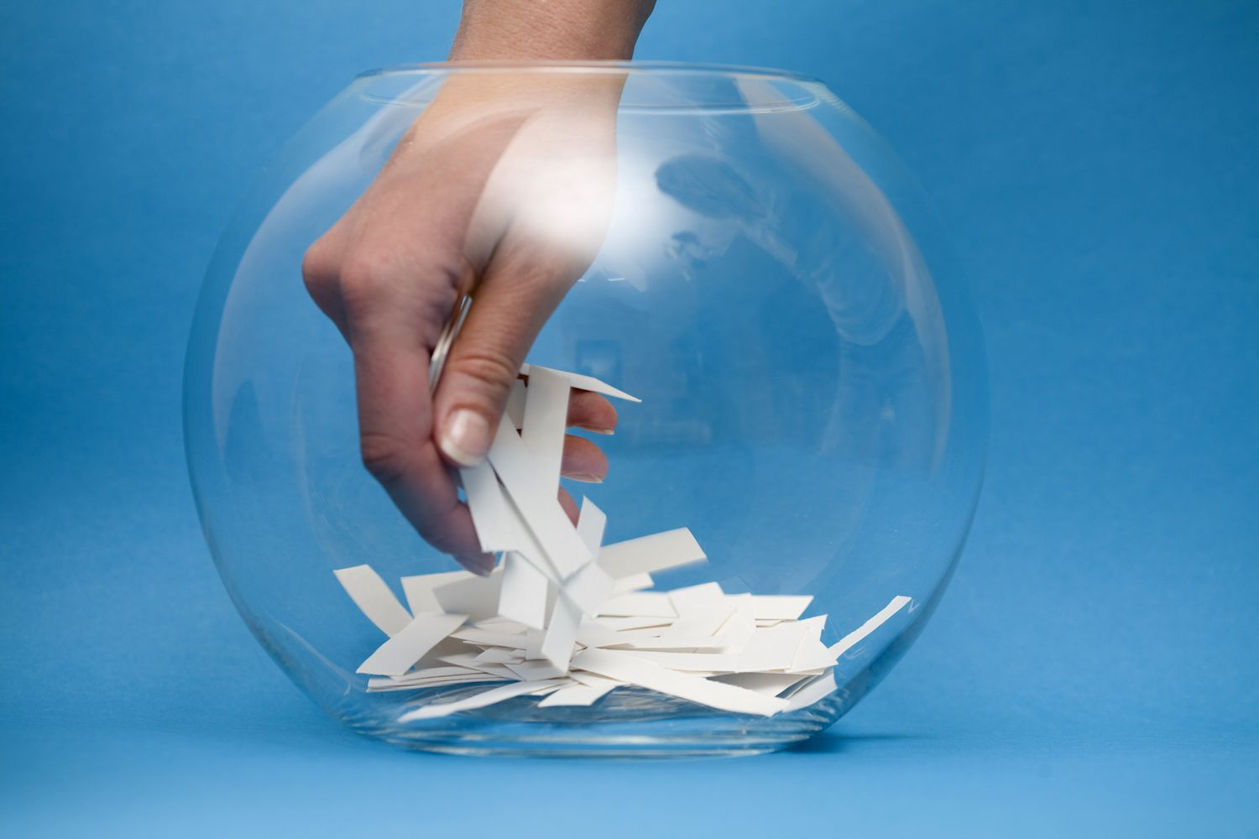

Slide 43
Brand Portfolios: Family vs Independent Brands

Slide 44
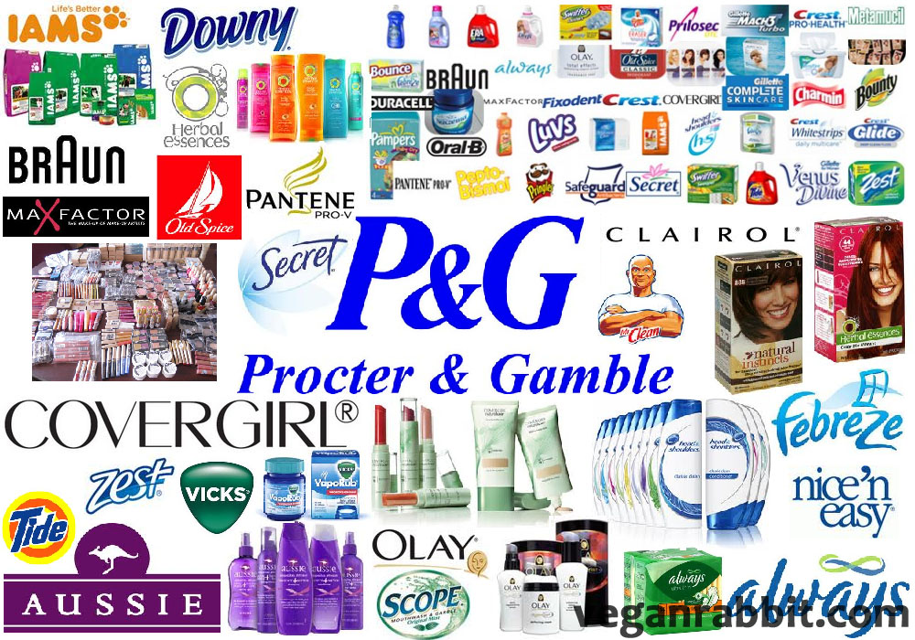

Slide 45
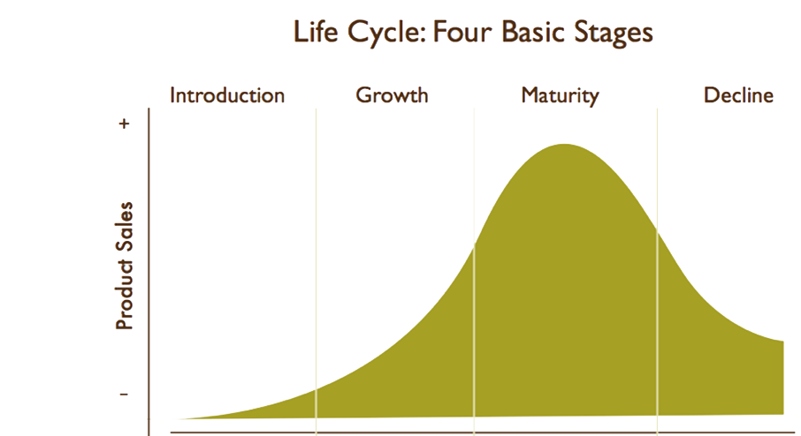
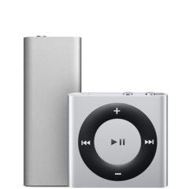
Profits peak
“Make or break”
Big investment required
Time

Slide 46
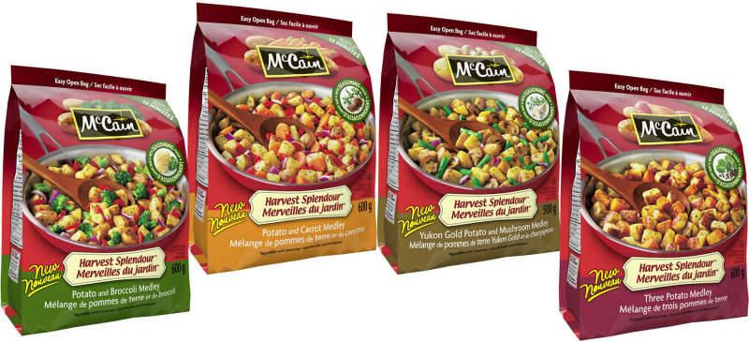
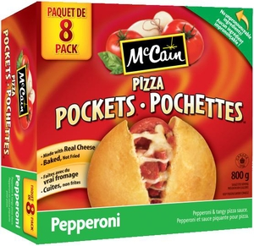
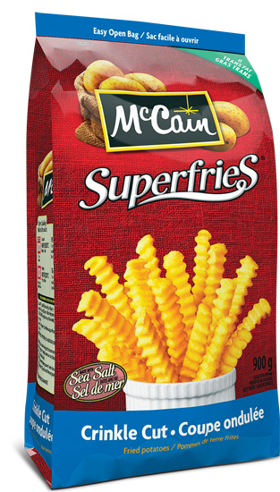
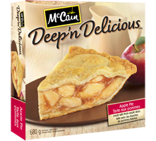
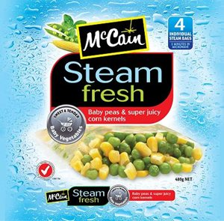
Family
vs Independent Brands

Slide 47
Family
vs Independent Brands

Slide 48
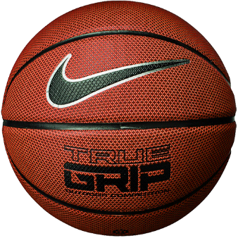
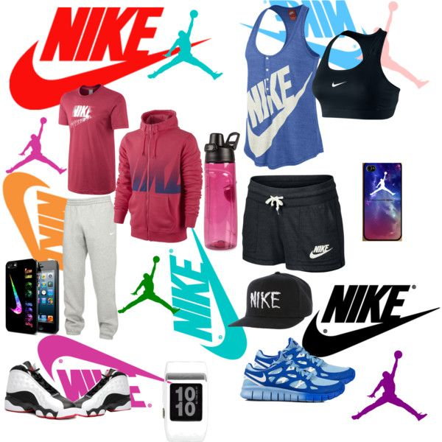
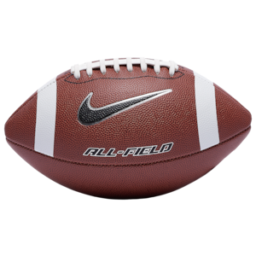
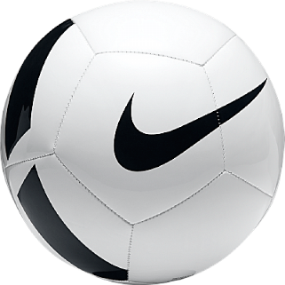

Slide 49
Family vs
Independent Brands

Slide 50
Family vs
Independent Brands

Slide 52
Family vs Independent Brands
Family
Independent
Inexpensive to promote
Leverages brand awareness
Hard to expand to new categories
High cannibalization
Expensive to promote
No parent brand to benefit from
Easy to expand to new categories
Little cannibalization

Slide 54
CANNABALIZATION!

Slide 55
Family vs Independent Brands
Family
Independent
Inexpensive to promote
Leverages brand awareness
Hard to expand to new categories
High cannibalization
Diluted brand image
All brands affected if company image is tarnished
Expensive to promote
No parent brand to benefit from
Easy to expand to new categories
Little cannibalization
Develops focused brands
Brands protected if company image is tarnished

Slide 56
Brand Elasticity
Brand elasticity is the measure of how far you can successfully stretch that brand to another product and still preserve the brand’s core positioning.

Slide 57
Family Brand Elasticity
There are two measures of evaluation inherent in this:
Did the extension successfully benefit the new brand?
Did the extension adversely affect the parent brand?

Slide 58
Family Brand Elasticity
Coca-Cola stands for mainstream refreshment, and people readily accept it as a sweet beverage, but not a healthy drink
Would you buy a Coca-Cola Sports Drink or Coca-Cola Baby Formula?

Slide 59
Coca-Cola is considering a move into the growing market for cannabis-infused drinks

Slide 60
Brand Portfolio
Coca-Cola
Diet Coke
A&W Root Beer
PowerAde
No baby formula!
The result is a portfolio of independent brands owned by Coca-Cola

Slide 62
Extending to Related Categories
Family cruises are a good complement to theme parks, so they launched Disney Cruise Lines

Slide 63
Extending to Related Categories
Violent adult films are NOT a good fit with Disney, so they launched Touchstone

Slide 64
Extending to Related Categories

Slide 66
Branding
Manufacturer’s brand
Individual (Independent)
Family
Cobranding
Generic (e.g. No Name)
Private Label

