Slide 1
Ecommerce Webinar

Slide 2
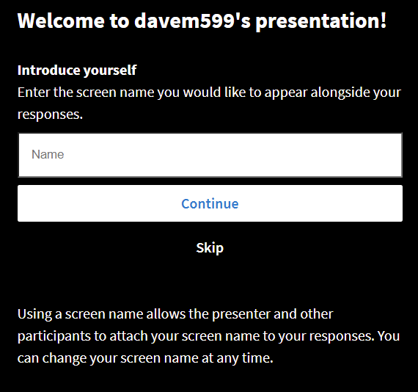
Please go to this web address to submit responses
Go to
pollev.com/davem599
on your phone,
tablet or computer
Select Continue

Slide 3
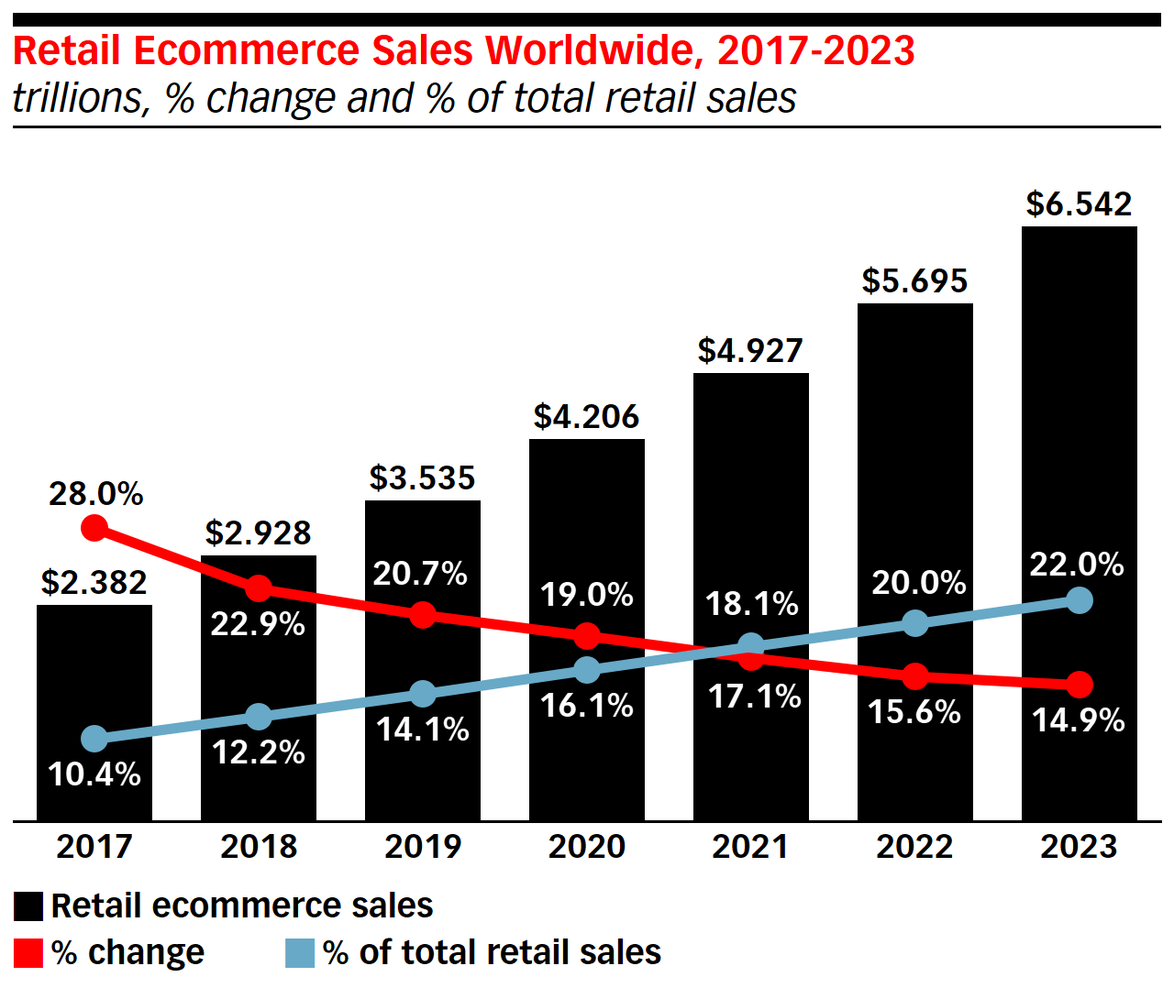

Slide 4
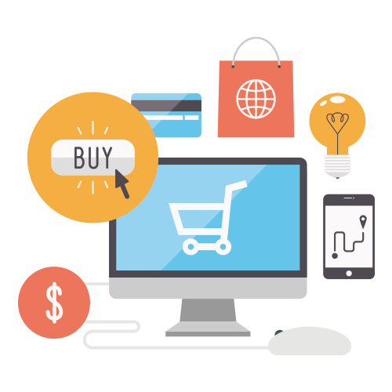
Where did you make your last 3 online purchases?

Slide 5
Notes:
Poll Title: Do not modify the notes in this section to avoid tampering with the Poll Everywhere activity. More info at polleverywhere.com/support Where did you make your last 3 online purchases? https://www.polleverywhere.com/free_text_polls/mGA5zVpXwDPuv73Nxtide

Slide 6
What is an ecommerce platform?
a software application that allows businesses to manage their website, marketing, sales, and operations in an integrated fashion.
Ecommerce transaction are facilitated using these platforms.
Shopify, BIGCOMMERCE, WIX, Google, Volusion, Bigcartel, 3dcart, and Ecwid are platform examples.

Slide 8
Bank account
Merchant account
Payment gateway
SSL certificate
Shopping cart
Website
OR
OR
OR

Slide 9
Bank account
Merchant account
Payment gateway
SSL certificate
Shopping cart
Website
2.9% & 30
per transaction

Slide 10
SSL Certificate
Requires an SSL Certificate to ensure secure transactions
SSL stands for Secure Sockets Layer, a global standard security technology that enables encrypted communication between a web browser and a web server

Slide 11
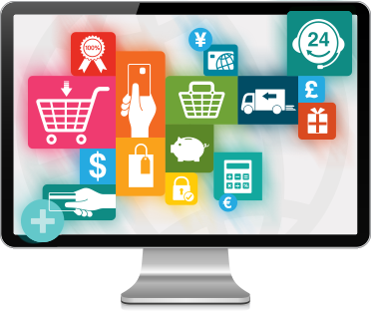
Criteria to select an ecommerce platform
Some criteria an organization might use to select an ecommerce platform include:
price
features and flexibility
availability of templates
SEO (search engine optimization)
customer support

Slide 12
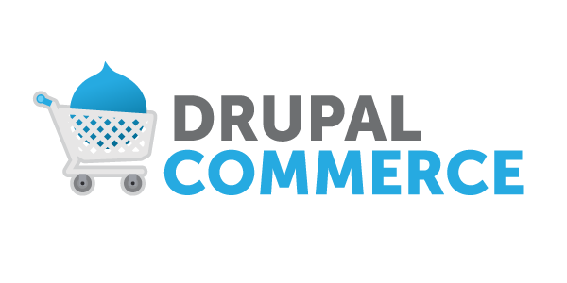
Price
Price can range from FREE to $100 a year to $2,000 plus a year

Slide 13
Availability of templates

Slide 14
Features and flexibility
Can you add features like
Video
Blogs
Sign up for newsletters
Maps
Book an appointment
Mobile version
Multi-currency

Slide 15
SEO (search engine optimization)
Properly building your site so that you earn high page rank in search engines
Translation…being found on Google
SEO

Slide 16
Customer support
Is there an extra cost
Is it by chat, phone and/or email
Do they have Help sections with commonly asked questions
Do they have a discussion forum

Slide 17
Notes:
Poll Title: Do not modify the notes in this section to avoid tampering with the Poll Everywhere activity. More info at polleverywhere.com/support What are the advantages of ecommerce? https://www.polleverywhere.com/discourses/UySbUySZYEUlllP2JrDjC

Slide 18
Notes:
Poll Title: Do not modify the notes in this section to avoid tampering with the Poll Everywhere activity. More info at polleverywhere.com/support What are the disadvantages of ecommerce? https://www.polleverywhere.com/discourses/JB4Dp9doK6AFofehG93Wj

Slide 19
Business Advantages
eliminates the need for physical stores
allows businesses to expand their customer base.
consumers get access to products that aren’t available in their local market
save money on rent, utilities, maintenance, and other costs associated with physical stores.
Savings can be passed on to consumers…lower prices
business can scale up (expand) easier than physical retailers.

Slide 20
Consumer Advantages
digital products can be sold online with little-to-no overhead cost.
shorter supply chain
keeping in contact with customers is often easier for e-commerce businesses.
track logistics, which is key to a successful e-commerce company.
open 24 hours a day, seven days a week.

Slide 21
Disadvantages
Many consumers still prefer the personal touch and relationships
No chance to physically handle/inspect/try on products
No ‘instant gratification’

Slide 22
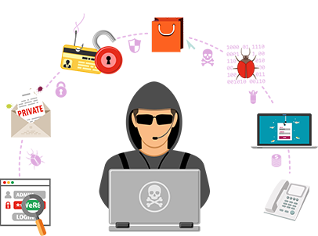
Disadvantages
Security and credit card fraud also have risks when dealing with online shopping.

Slide 23
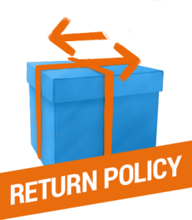
Disadvantages
Returns are more complicated

Slide 24
Let’s build an ecommerce website in less than 60 minutes!

Slide 25
FREE ecommerce website*
* They keep 2.9% + 30 cents per transaction
Upgrade benefits

Slide 26
Watch this (and many other videos) on YouTube
Follow this link for step-by-step instructions

Slide 27
Sign up for a free account

Slide 28
Enter your basic store details
(no credit card or bank account required right away)

Slide 29
Set up Categories
Enter Items

Slide 30
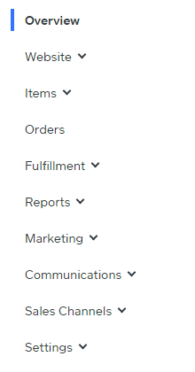
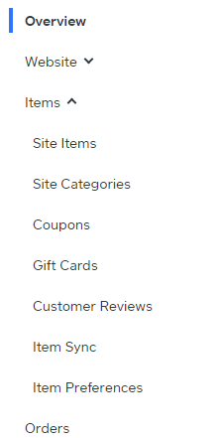
Set up Categories
Enter Items

Slide 31
Edit your website template

Slide 32
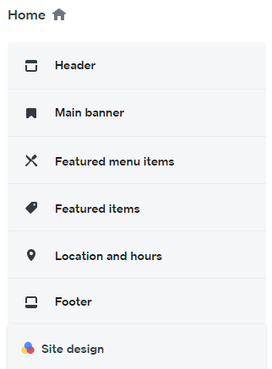
Edit your website template

Slide 33
Set up your 1. Domain
2. Shipping
3. Taxes

Slide 34
https://www.amazon.ca/
Set up your 1. Domain (custom domain name requires upgrade)
2. Shipping
3. Taxes

Slide 35
Link your bank
account

Slide 36
IMPORTANT
‘Not accepting orders’
Deactivate account

Slide 37
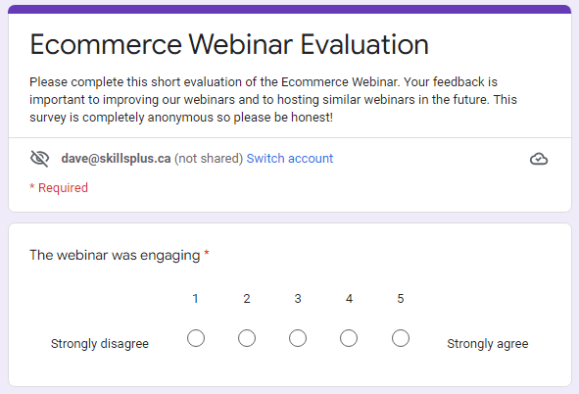

Slide 38
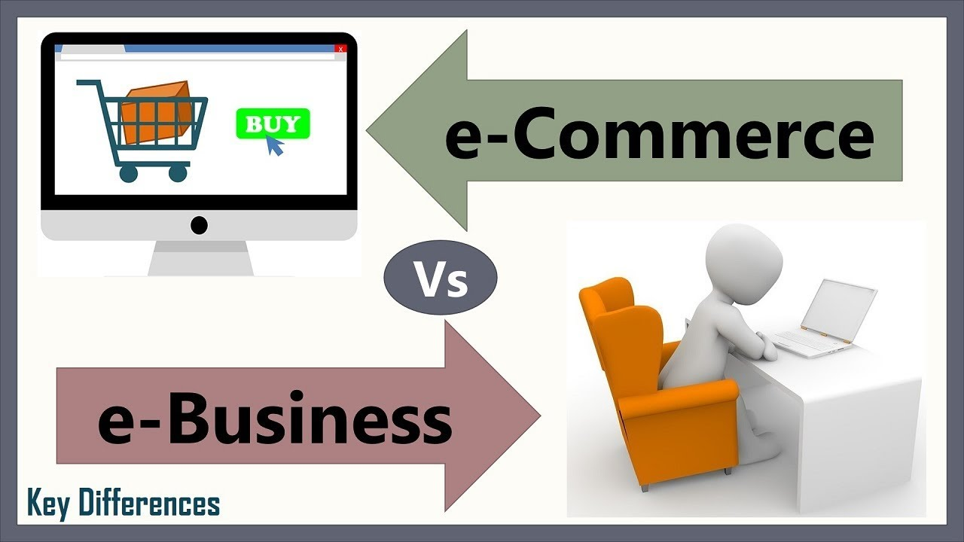
Ecommerce
Ecommerce: commercial transactions that are facilitated through the internet, primarily the transaction of goods and services online.
E-business: all aspects of operating an online business.

